Slide 1
לין נחמד רוטרי כפר סבא 2019
2019-2020

Slide 2
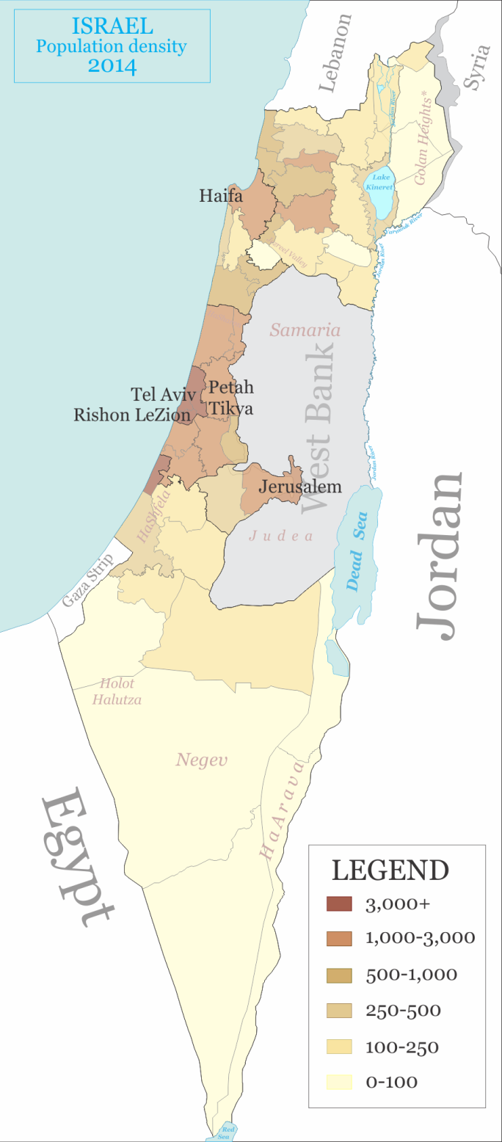
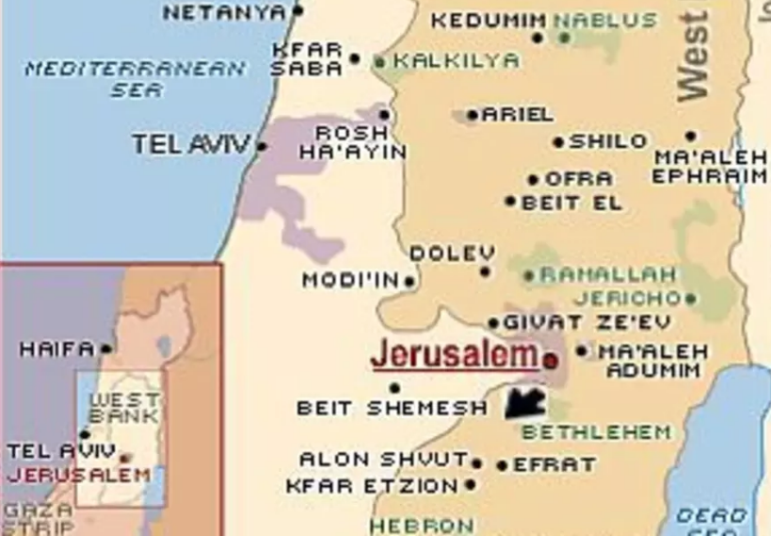
District 2490 : 58 ROTARY CLUBS
1.500 Members
Kfar Saba Rotary Club 13461
לין נחמד רוטרי כפר סבא 2019

Slide 3
לין נחמד רוטרי כפר סבא 2019

Slide 4
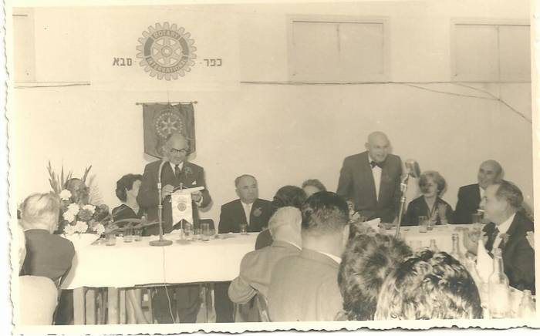
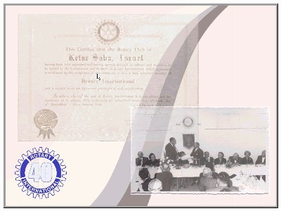
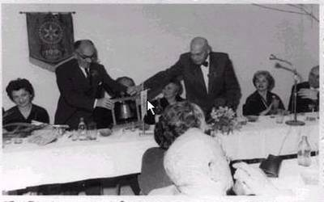
ROTARY CLUB KFAR SABA
23.12.1960
First President :
Israel Gotman
לין נחמד רוטרי כפר סבא 2019

Slide 5
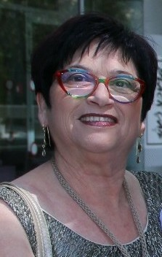
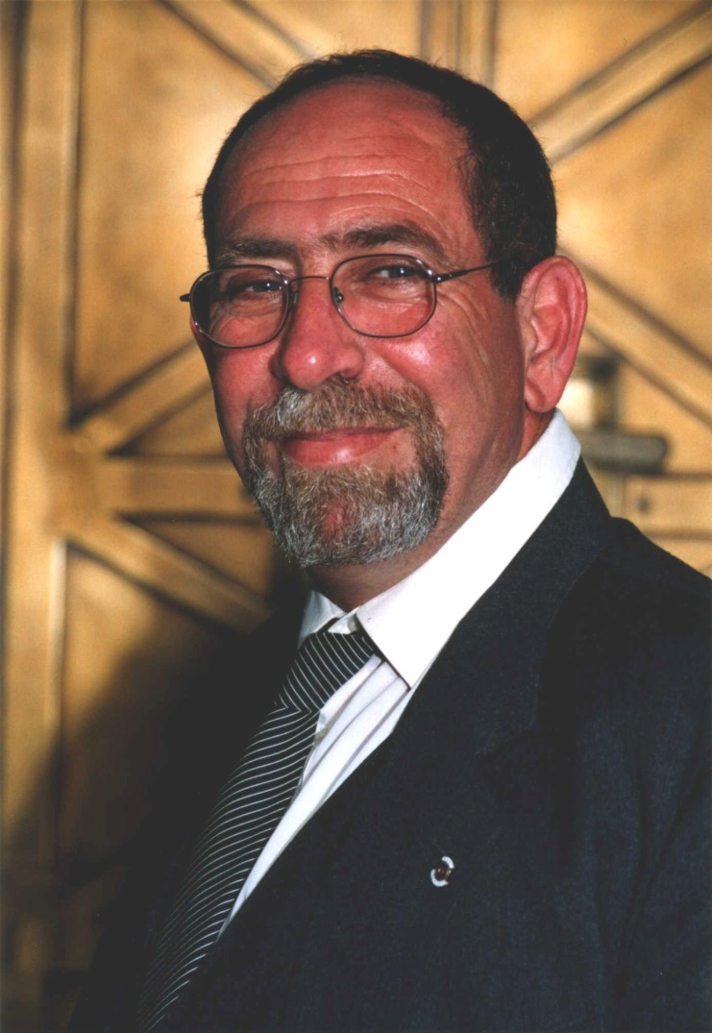
Tzila Reshtik
Presidente
Aby Brakha
secretary
לין נחמד רוטרי כפר סבא 2019
2019-2020

Slide 6
לין נחמד רוטרי כפר סבא 2019
51 members – all as one

Slide 7
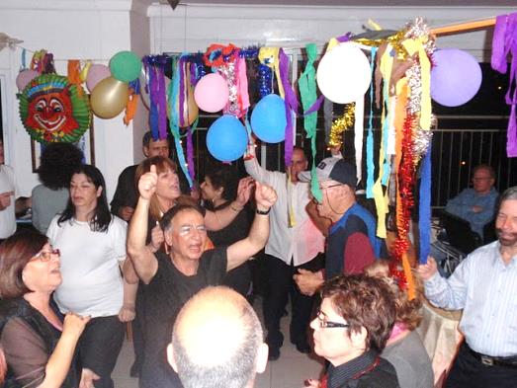
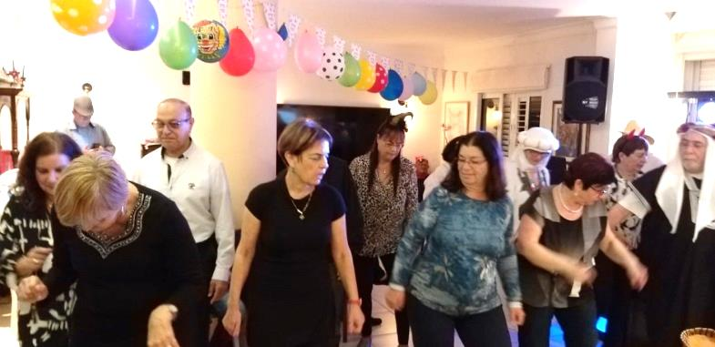
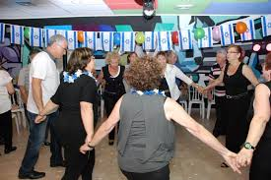
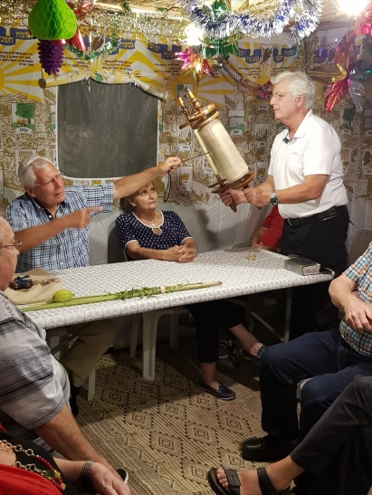
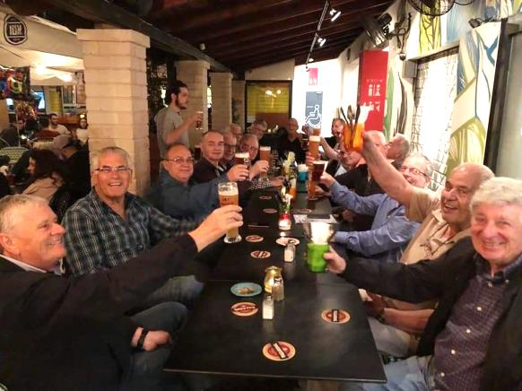
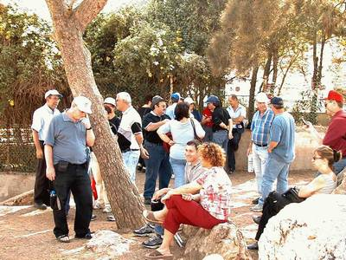
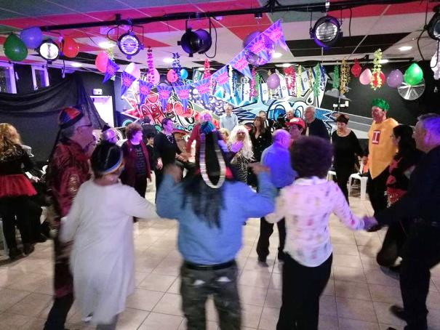
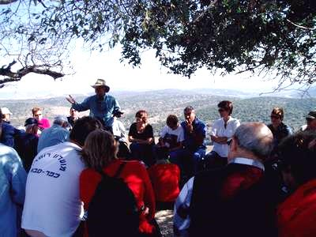
Friendly
activities
independance day
NEW YEAR
HOLIDAYS
Trips ….
לין נחמד רוטרי כפר סבא 2019

Slide 8
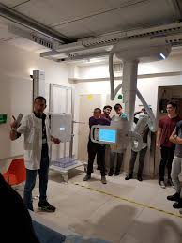
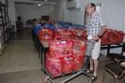
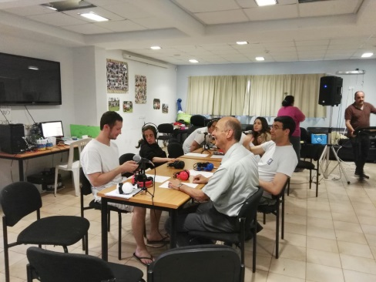
SOME OF COMMUNITY
MAJOR PROJECTS
Our club has contributed special equipments (glasses) for children surgery in the Meir Medical Centre
We help fighting violence among youngsters : children learn how to solve their disputes via mediations skills
We distribute food for needy families and individuals
לין נחמד רוטרי כפר סבא 2019

Slide 9
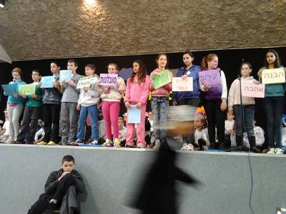
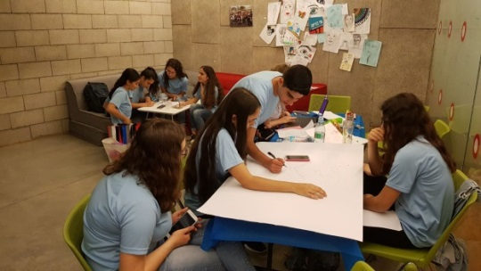
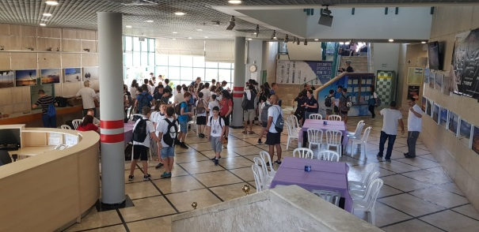
SOME OF COMMUNITY
MAJOR PROJECTS
The club provides musical instruments and equipment for the youth bands where music practises improve self image and help socialization
Important new contribution consists of robotics based projects in junior high-schools
We enable the Radio internet for the retarded youngsters, who actually broadcast light musical programs
לין נחמד רוטרי כפר סבא 2019

Slide 10
SOME OF COMMUNITY
MAJOR PROJECTS
We cooperate with the municipality in order to reduce the amount of waste
Recently we have provided a dryer and household equipment for a group of girls lacking the family support
We support creative scientific approach to problems for high school students within a specific project (recent project: how enable humans to inhabit the Mars planet )
לין נחמד רוטרי כפר סבא 2019

Slide 11
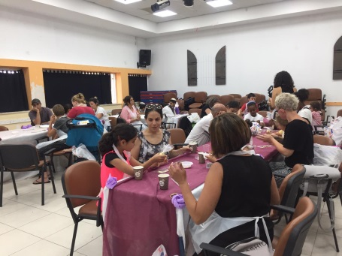
SOME OF COMMUNITY
MAJOR PROJECTS
RC Kfar Saba has donated this year school uniforms for needy students
We organize contests where young speakers talk about a specific issue before large audiences
We support amateur theatre of elderly ladies from the suburbs
Some of our members are voluntary teachers helping children of difficult social background
לין נחמד רוטרי כפר סבא 2019

Slide 12
לין נחמד רוטרי כפר סבא 2019
Town of Kfar Saba

Slide 13
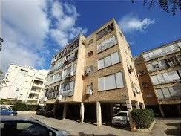
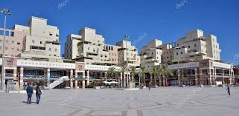
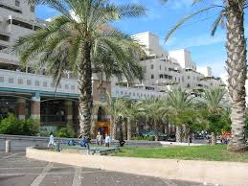
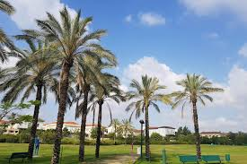
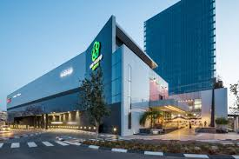
Town of Kfar Saba :
More than 100,000 inhabitants
לין נחמד רוטרי כפר סבא 2019

Slide 14
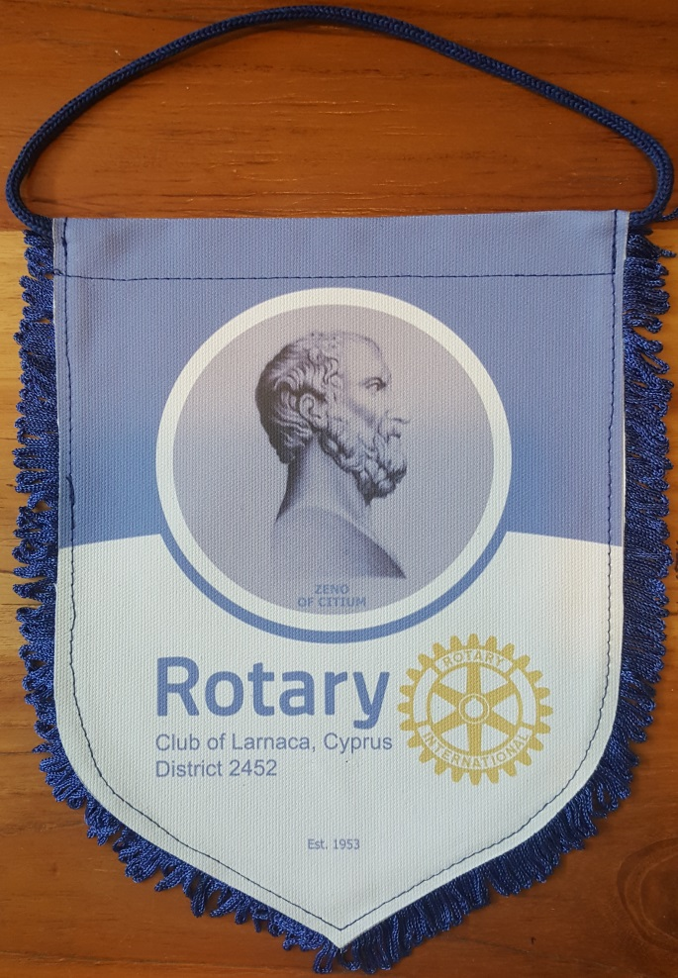
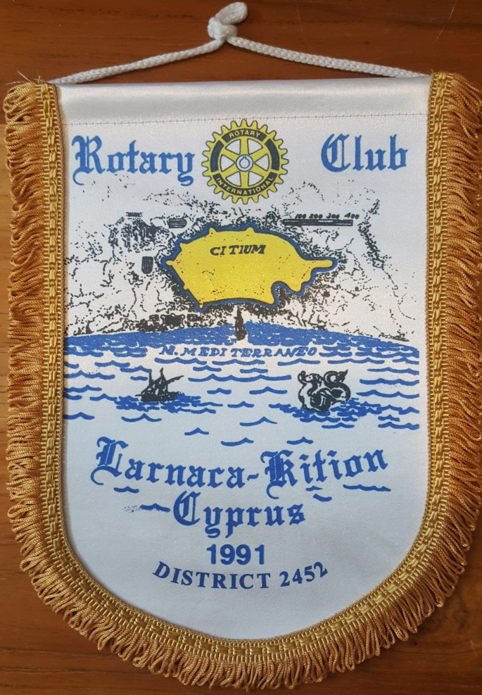
Thank you for your attention
and consideration
לין נחמד רוטרי כפר סבא 2019
Presentation : Yossi Ben Ami
Design : Line Nehmad
Translation (english): Hanan Hass
Activity pictures : Yaacov Kantrovitz
2019-2020

Slide 15
www.rotary-kfar-saba.org.il
לין נחמד רוטרי כפר סבא 2019
Presentation : Yossi Ben Ami
Design : Line Nehmad
Translation (english): Hanan Hass
Activity pictures : Yaacov Kantrovitz
2019-2020

