Slide 1
Pre Game
Plate Meeting
Post Game

Slide 2
Prior to Game and on Arrival at the Field:
Confirm assignment: Game time, field, parking location, colors.
Use email or phone your partner at least a day ahead of the game.
Arrive at the field at least 30 minutes before game time.
Check condition of the field.
Check in with coaches / tournament director / umpire crew chief

Slide 3
Pre Game Meeting w/ Partner
Catch/no-catch coverage in the outfield
Fair/foul coverage
Umpire Signals & making eye contact (cover all of your signals)
Checked swings
First-to-third rotation (agree on signals)
PU has touches and tags at 3rd with runners on
PU rotations (staying home, covering third, covering catch/no-catch)
U1 going out (PU has batter-runner all the way)
Rundowns (when and how to join)
Calling balks
Foul ball off the batter in the box (“see it, call it”)
Overthrows out of play (“see it, call it”)
Running lane interference
Force-play slide violation/interference (PU needs to help)
Swipe tag / pulled foot at 1st base (PU needs to help)
Appeals, touches, tags (be clear who owns what and when)
Getting the call right (discuss getting together)
"I have information for you" (discuss a signal)

Slide 4
The Plate Meeting
Should begin no less than 5 minutes before game time
Should include:
Plate Umpire
Base Umpire(s)
Head Coaches
Plate umpire at point of the plate
Base umpire at head of the plate
Coaches in each box

Slide 5
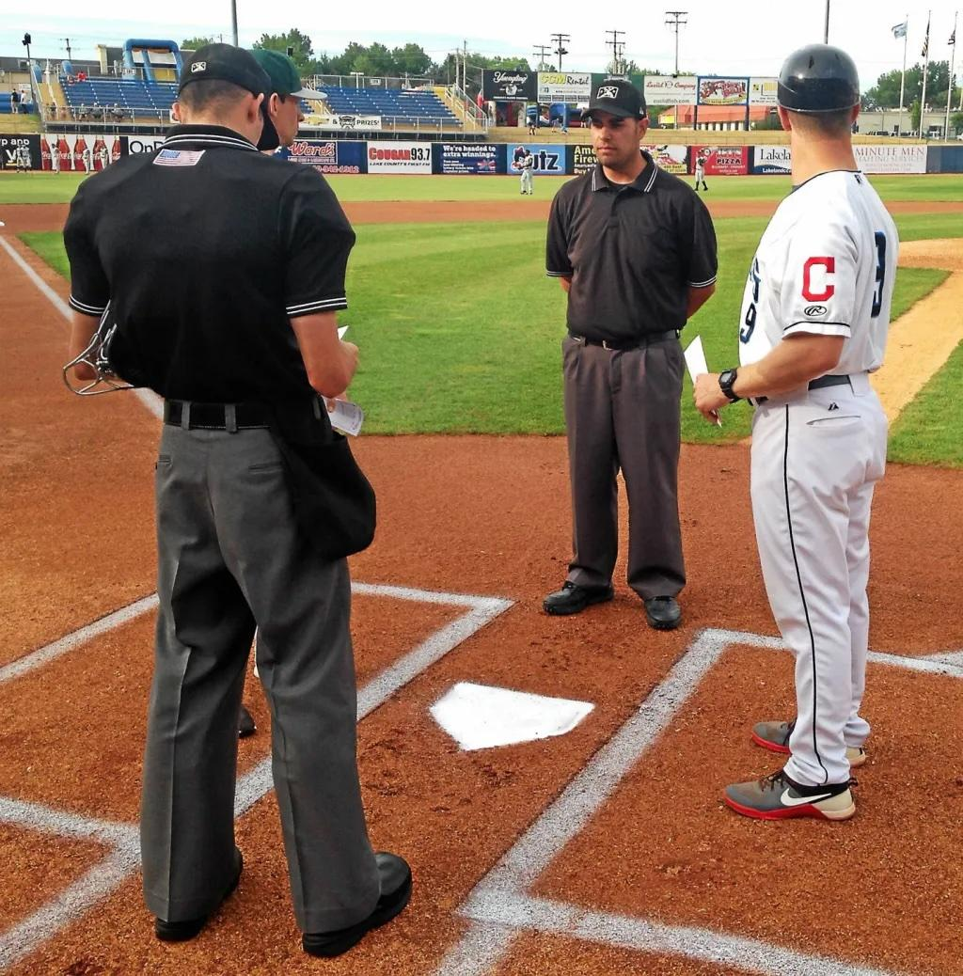

Slide 6
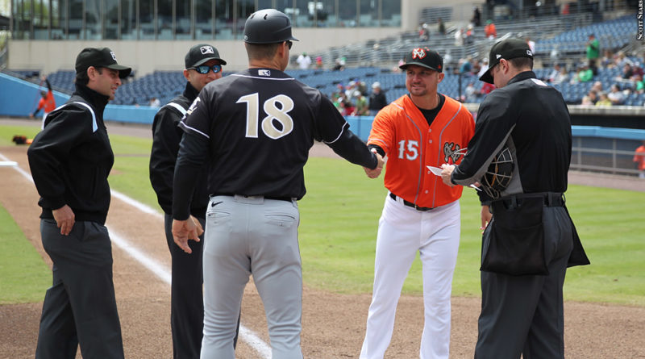

Slide 7
The Plate Meeting
Plate Umpire Conducts the Plate Meeting
Plate Meeting Agenda
Introducations & Hand Shakes
Request Line-ups (only certain games/tournaments)
Mandatory Items
Ground rules / tournament specific rules
Are your players legally & properly equipped?
Sportsmanship

Slide 8
Post Game
Umpires get together to discuss how the game went
Discuss any situations that arose during the game
Each umpire should be willing to give and receive feedback
A large part of improving is being coachable

