Slide 1
Muscle, Joint and Low Back
Pain Management Devices
Proof-of-concept Pitch, 26 May 2024

Slide 2
Company Purpose
To help millions of people suffering from muscle, joint and lower-back pain by providing affordable and accessible home-use pain management devices based on smart vibration and electromechanical massage technology.
Confidential. © InfiniWave Therapeutics Ltd. www.infiniwave.co.uk

Slide 3
Problem
About 47% of the world population experiences muscle pain at any given time¹ .
619 million people were affected by lower back pain globally in 2020 . This number is expected to grow by around 10 million per year² .
Economic loss is estimated at US$50 Billion - US$100 Billion per year (in USA alone)³ .
Confidential. © InfiniWave Therapeutics Ltd. www.infiniwave.co.uk

Slide 4
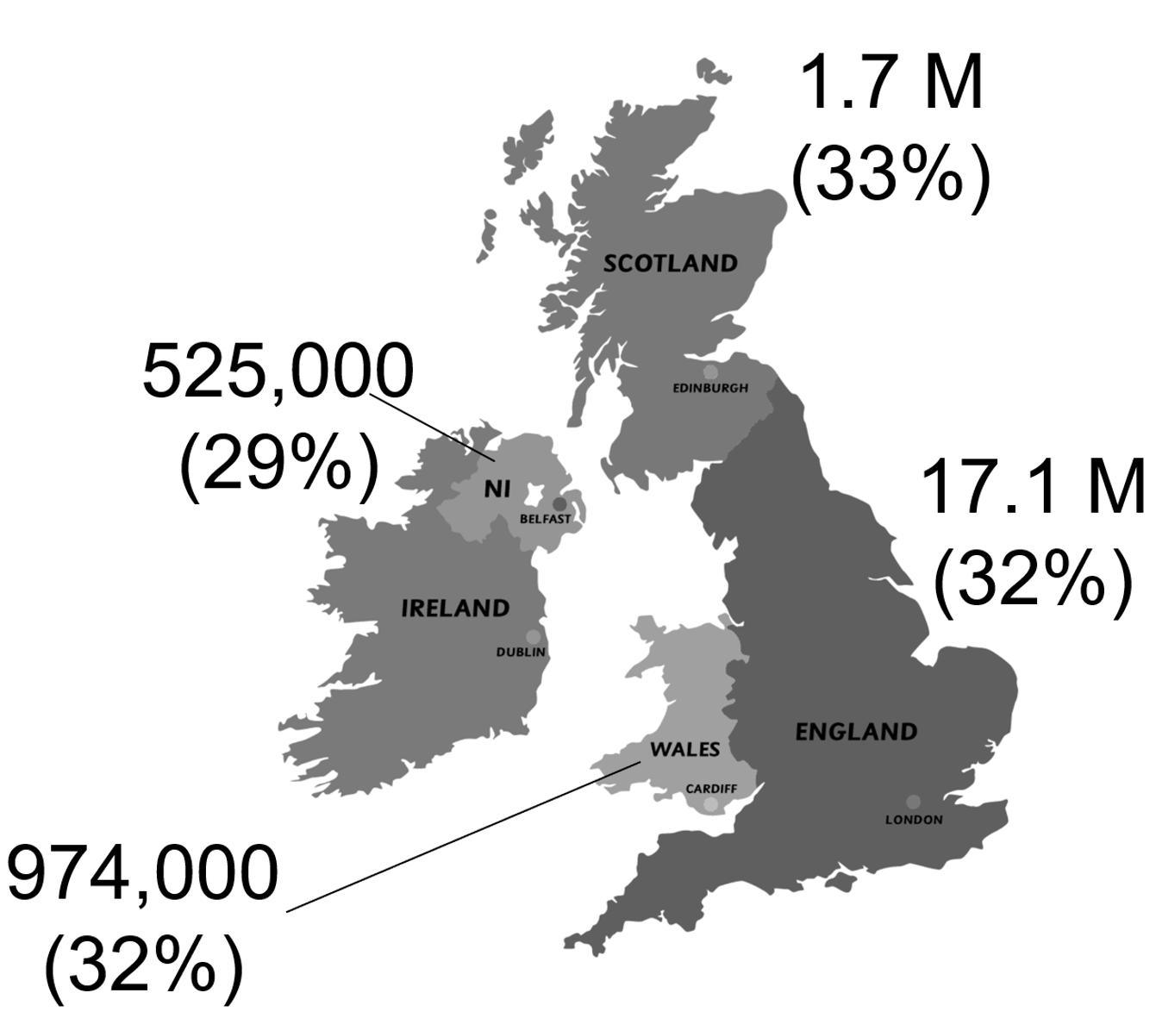
Problem
More than a third
of the UK population lives with a musculoskeletal condition.
Confidential. © InfiniWave Therapeutics Ltd. www.infiniwave.co.uk

Slide 5
Solution
The idea is to translate the manual therapy techniques (massage, mobilisation, stretching, decompression, etc.) into the device operation.
The therapeutic action will be achieved through smart vibration, circular pressure, release motion, and sensing of the tissue in the application area .
Confidential. © InfiniWave Therapeutics Ltd. www.infiniwave.co.uk

Slide 6
Solution
An online AI-based platform will capture initial self-assessment customer feedback to generate a pain management plan with the most suitable device addressing specific pain causes.
This app will track pain management progress and will also create recommendations on suitable exercises and lifestyle changes to relieve muscular and lower back pain.
Confidential. © InfiniWave Therapeutics Ltd. www.infiniwave.co.uk

Slide 7
Why Now?
The cases of muscle pain and musculoskeletal conditions, including lower back and neck pain are increasing globally (+10M per year), due to several reasons such as sedentary lifestyles, ageing population, stress, depression and anxiety, obesity and occupational factors.
Confidential. © InfiniWave Therapeutics Ltd. www.infiniwave.co.uk

Slide 8
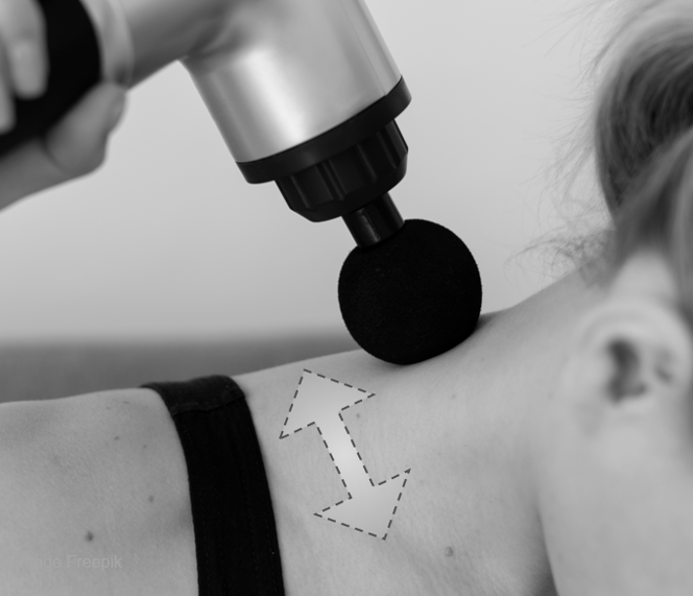
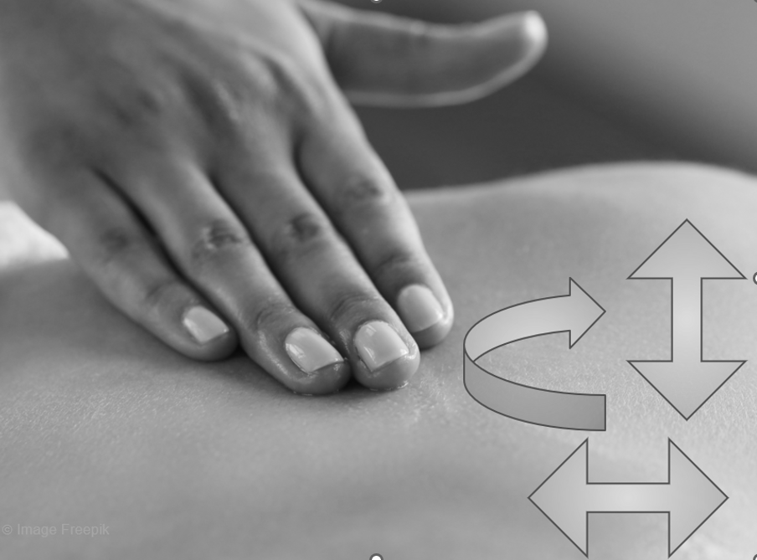
Product
There is a range of exceptionally successful therapeutic devices, for example, percussion massage guns, shiatsu massage chairs or vibrotherapy mattresses.
We are working on a conceptually new device that will create full 3D pressure motion patterns manually selected by the device user or generated by the app connected to the device.
Confidential. © InfiniWave Therapeutics Ltd. www.infiniwave.co.uk

Slide 9
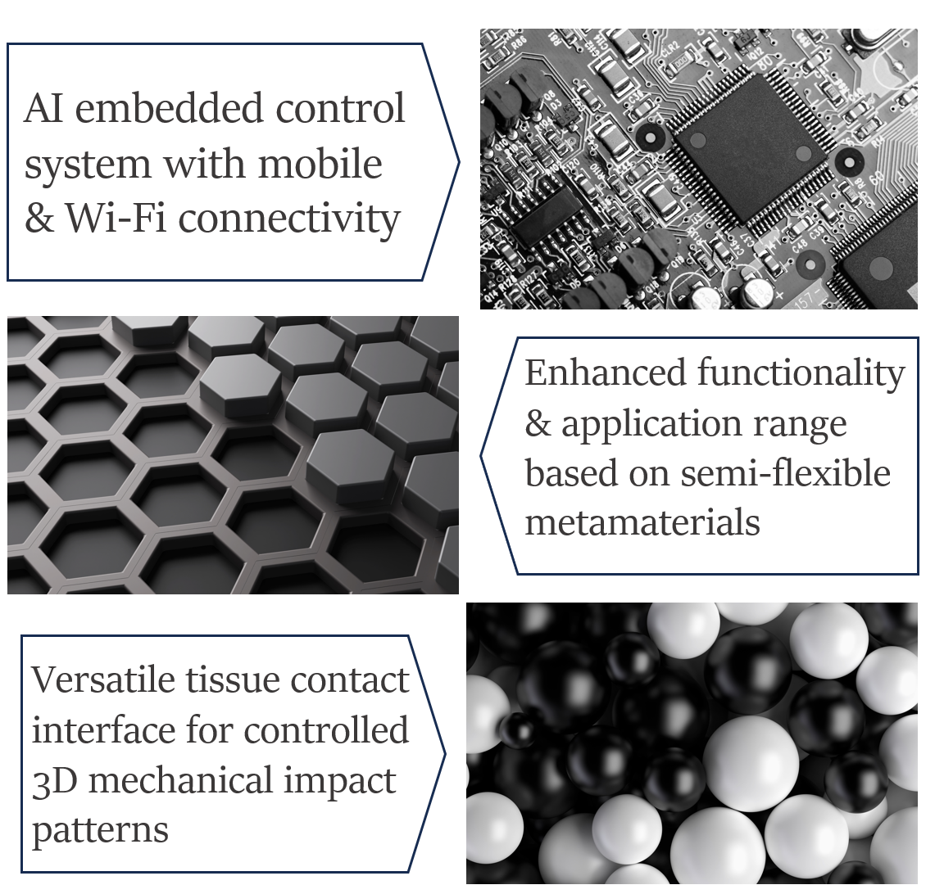
Innovation & Technology Stack
Our innovation areas include device functional elements and AI-based embedded control systems. Novel concepts will be implemented, such as mechanical metamaterials for enhanced functionality and supercapacitors replacing Li-Ion batteries for environmental impact minimisation and cost reduction.
Confidential. © InfiniWave Therapeutics Ltd. www.infiniwave.co.uk

Slide 10
Customer Acquisition & Retention
Our customer acquisition and retention strategy will rely on connecting with a customer through the online platform to establish an optimal pain management plan, monitor pain relief progress and provide lifetime support for our devices with optional upgrades. The app will be used to connect a customer to an AI assistant (free) or a human medical specialist as a premium service.
Confidential. © InfiniWave Therapeutics Ltd. www.infiniwave.co.uk

Slide 11
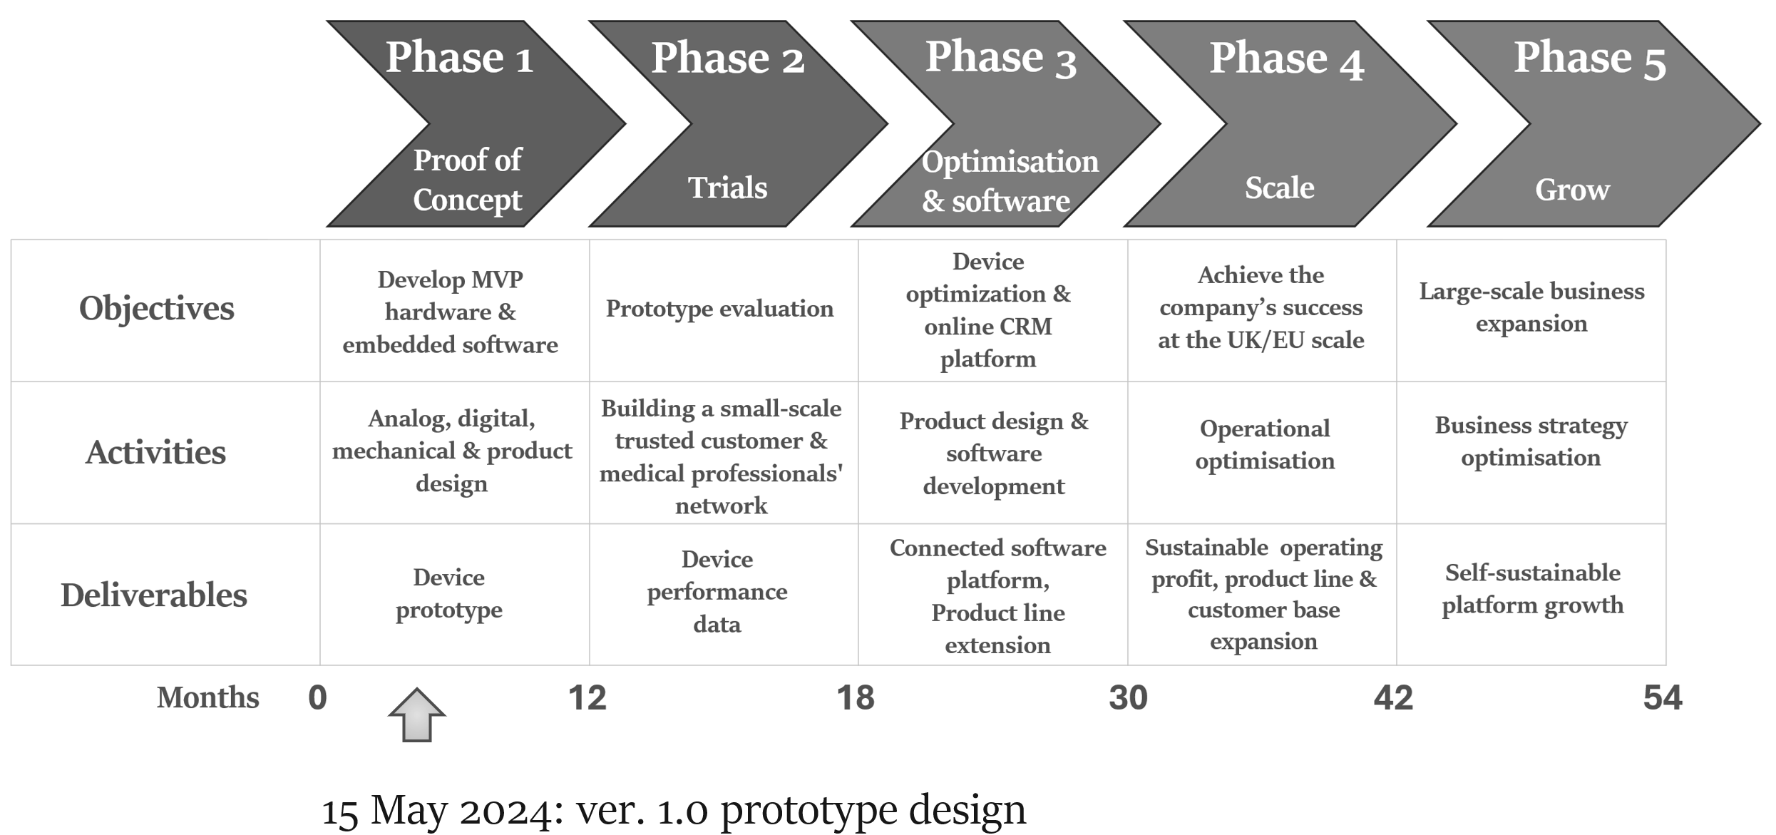
Product & Company Roadmap
Confidential. © InfiniWave Therapeutics Ltd. www.infiniwave.co.uk

Slide 12
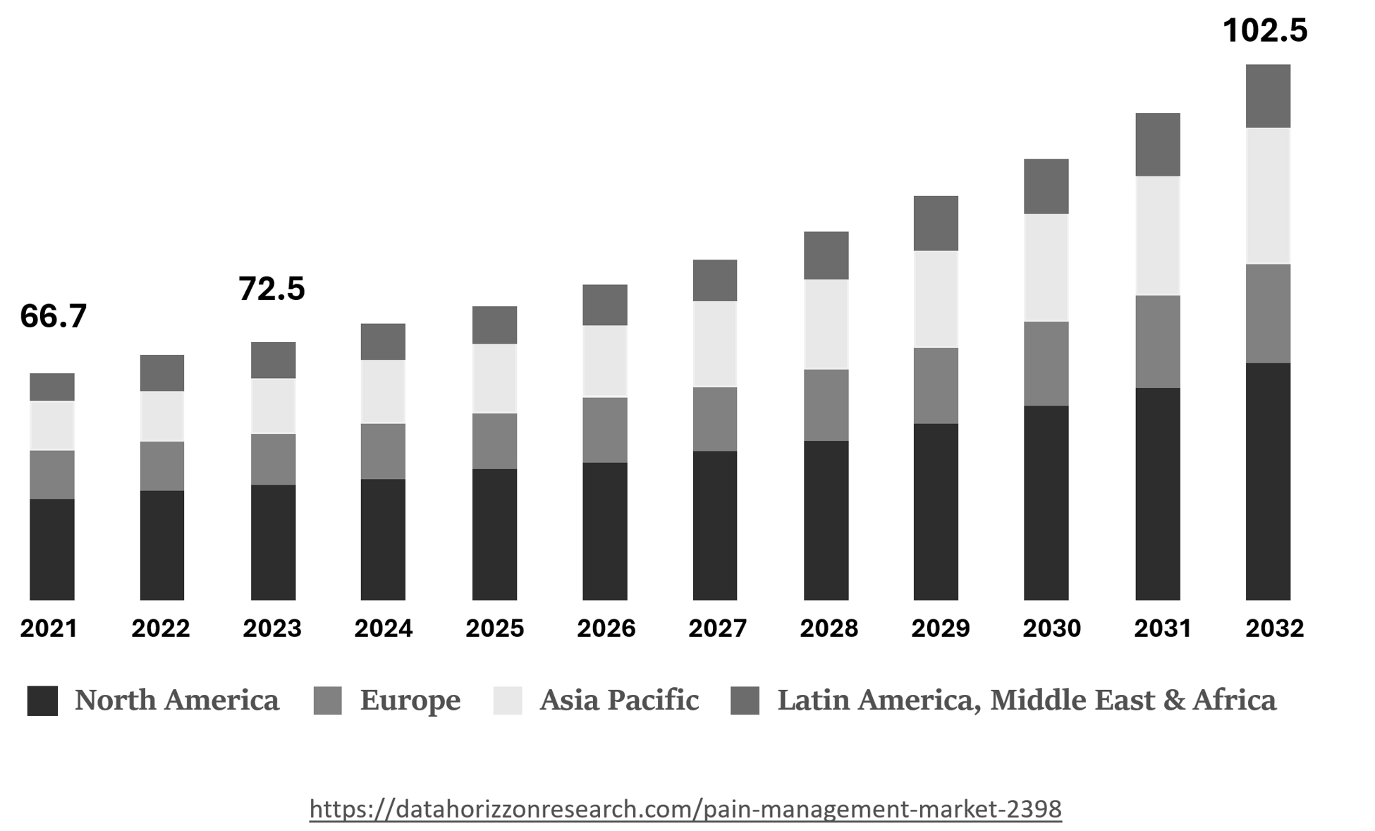
Total Pain Management Market, USD Billion
Confidential. © InfiniWave Therapeutics Ltd. www.infiniwave.co.uk

Slide 13
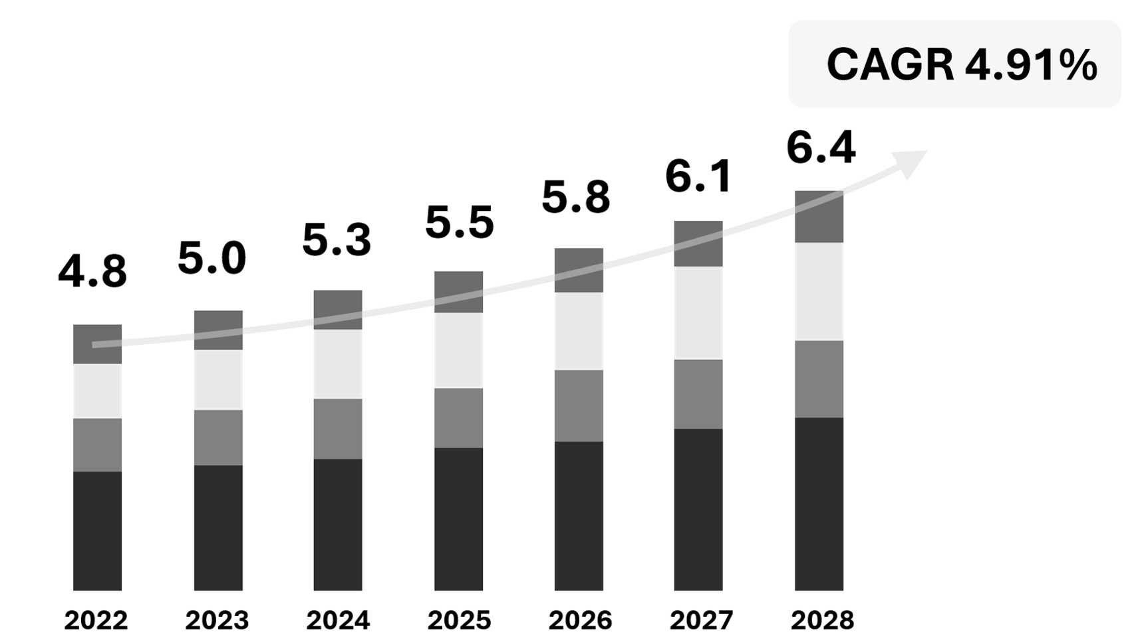
Addressable Pain Management Market
USD Billion
Adapted from the DHR report, 2024
Confidential. © InfiniWave Therapeutics Ltd. www.infiniwave.co.uk

Slide 14
Confidential. © InfiniWave Therapeutics Ltd. www.infiniwave.co.uk

Slide 15
Business Model
Personalised
Pain Management
Device as a Service
Direct-to-Consumer Sales
Medical Professionals
Testers
Patients
Muscle
Lower back
Chronic pain
Online Platform
R&D and Innovation
B2B
& Platform Monetisation
Branding
Marketing
Advertising
Engineering Know-how
Manufacturing
Supply chain
Environmentally Friendly Design
Inventory
Confidential. © InfiniWave Therapeutics Ltd. www.infiniwave.co.uk

Slide 16
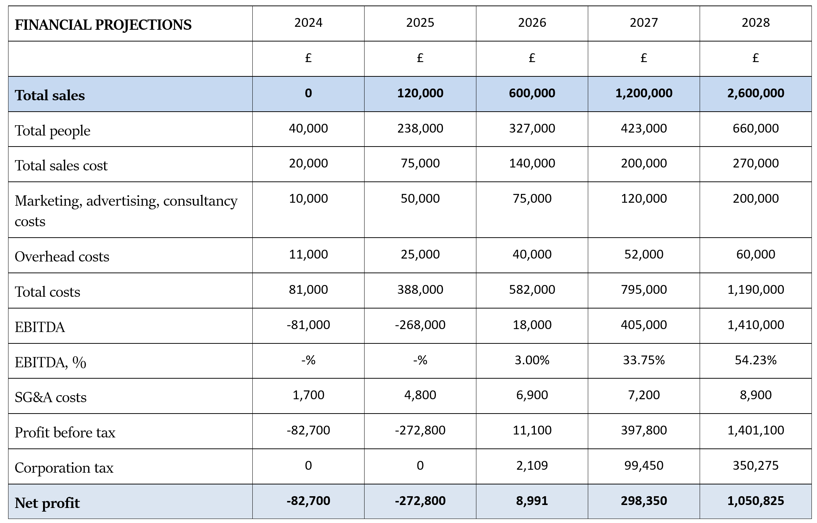
Confidential. © InfiniWave Therapeutics Ltd. www.infiniwave.co.uk

Slide 17
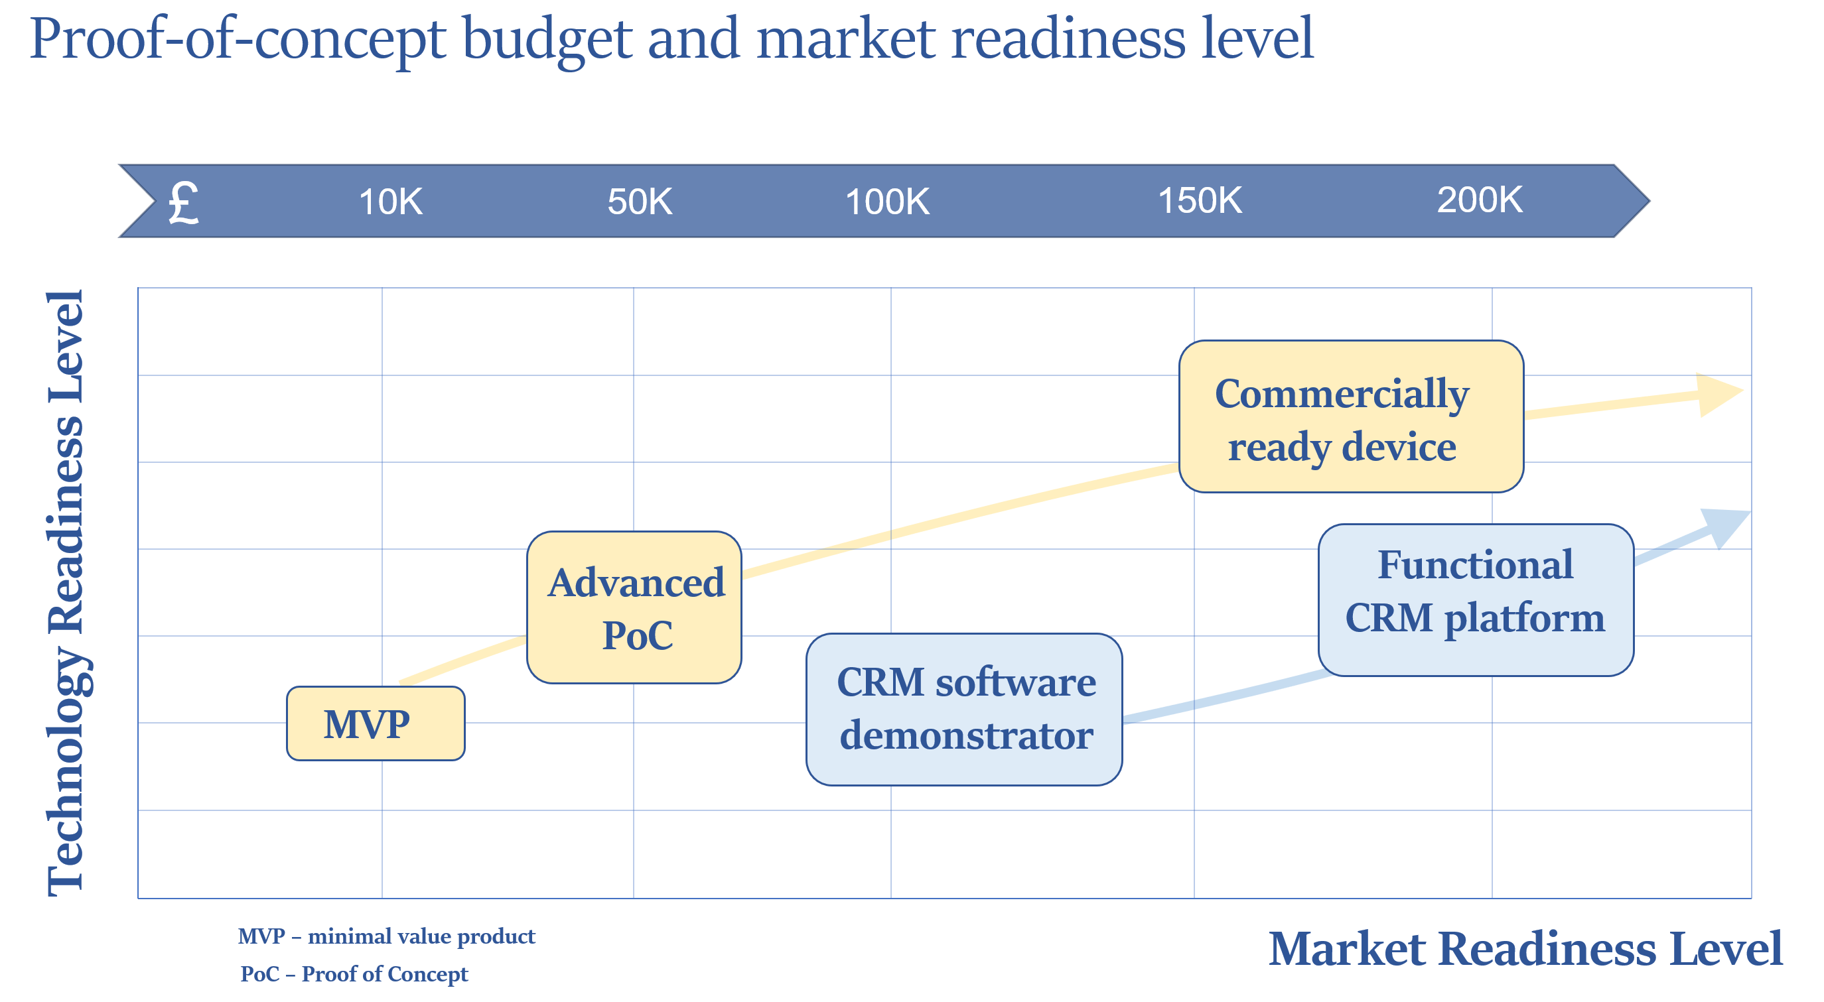
Proof-of-Concept Funding
Confidential. © InfiniWave Therapeutics Ltd. www.infiniwave.co.uk

Slide 18
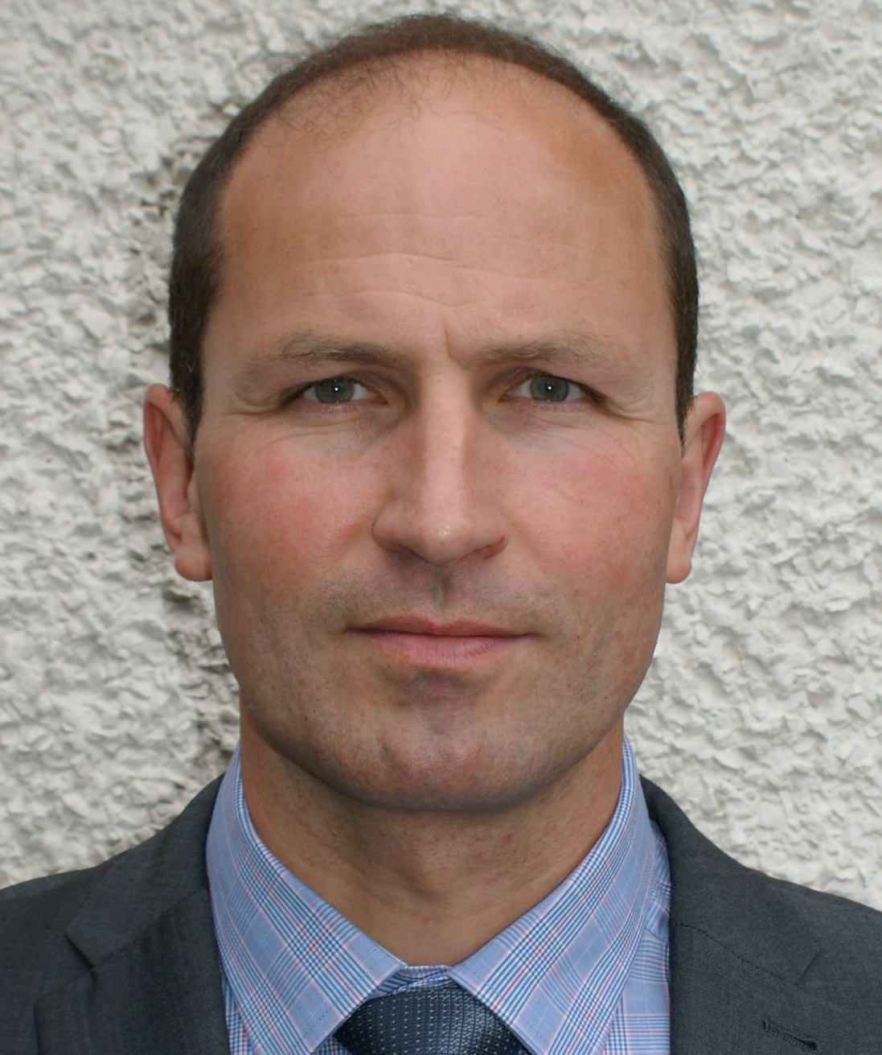
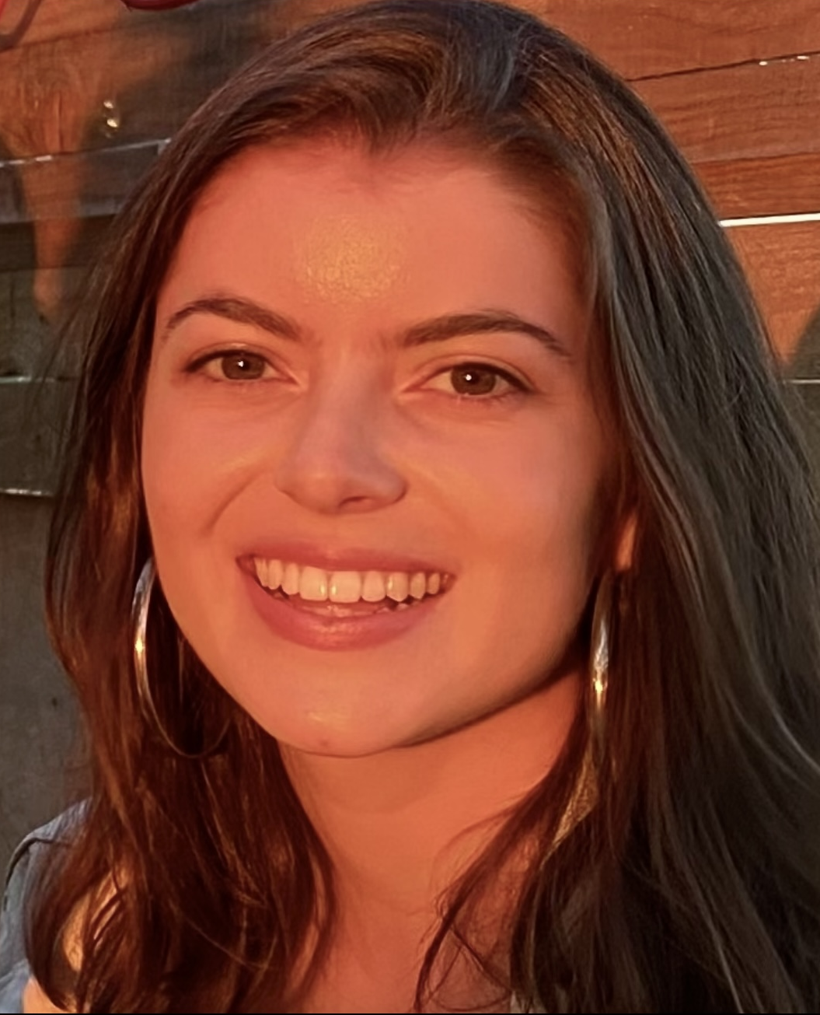
Team
Dr Oleksandr Malyuskin
Founder & CEO
15+ years experience in R&D and technical consultancy in embedded design, sensing, imaging and wireless communications.
Successfully developed several automotive, marine and sensor devices: MIMO sonar (2022-2024), vibroacoustic sonar (2023), microplastic electromagnetic sensor (2019), nanomaterial-enabled temperature sensor (2018), edema biomedical sensing device (2017), multi-functional RF automotive sensor (2015-2016).
Funding portfolio >£2.5M, 50 IEEE/IET publications.
Lia Pellegrini
Product Design Leader
Graduate MEng student in Product Design Engineering, Queen’s University Belfast.
Passionate and driven by excellence in design engineering with industrial experience in delivering design solutions at BLK BOX studio in Belfast, Northern Ireland. Presently engaged in the entrepreneurial Catalyst programme, with a strategic focus on innovations within the healthcare sector. 2024 Queen’s University Dragon’s Den finalist and special prize winner.
Cormac Browne
Mechanical Design Leader
Mechanical and Aerospace Engineering student, Queen’s University Belfast.
Actively engaged in the technology learning process with an interest in avionics, sensing and biomechanics and hands-on experience in design, 3D fabrication and electromechanical integration.
2024 Queen’s University Dragon’s Den finalist.
Confidential. © InfiniWave Therapeutics Ltd. www.infiniwave.co.uk

Slide 19
Thank you very much for your time
Any feedback/help/advice would be most appreciated!

