Slide 1
MEDICAL MELODY

Slide 2
DESCRIBE WHAT YOU CAN SEE ?

Slide 3
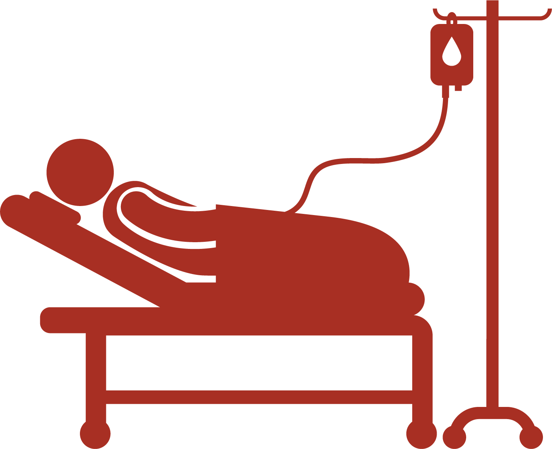
HEAD
SALINE or BLOOD BAG
LINE
THE PATIENT
I V SUPPORT
HEAD RECLINER
TROLLEY

Slide 4
ITEMS AND MEANINGS
ITEM
MEANING
TROLLEY
IV DRIP OR LINE
IV SUPPORT
BLOOD OR SALINE BAG
USED TO PUSH PEOPLE FROM PLACE TO PLACE
USED TO SUPPLY FLUIDS OR BLOOD TO THE PATIENT
USED TO HOLD THE BLOOD OR SALINE BAG IN POSITION
USED TO STOCK SALINE (SUGAR) SOLUTION OR BLOOD

Slide 5
SAMPLE VOCABULARY
TO PUSH (Pousser)
TO SUPPLY (Fournir)
I/YOU/WE/THEY PUSH BUT HE/SHE PUSHES – Present Simple
YOU/WE/THEY ARE PUSHING BUT I AM PUSHING AND HE/SHE IS PUSHING – Present Continous ( action happening right now)
I/YOU/HE/SHE/WE/THEY PUSHED – Simple Past
I/YOU/HE/WE/THEY WILL BE PUSHED- Future
I/YOU/WE/THEY SUPPLY BUT HE/SHE SUPPLIES – Present Simple
I/YOU/WE/THEY ARE SUPPLYING BUT I AM AND HE/SHE IS SUPLYING – Present Continous ( action happening right now)
I/YOU/HE/SHE/WE/THEY SUPPLIED – Simple Past
I/YOU/HE/WE/THEY WILL BE SUPPLIED- Future

Slide 6
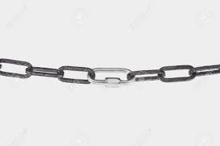
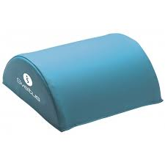
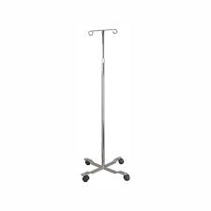
WORD GAP FILL
FIND THE MISSING WORDS
CLUES
THE PATIENT IS…………TO THE DRIP
THE PATIENT IS………..ON THE TROLLEY
THE PATIENTS HEAD IS SUPPORTED BY THE…………………………………
THE IV BAG IS ATTACHED TO THE……………….

Slide 7
ANSWERS
PRONOUNCIATION
WORD
ATTACHED
LAYING DOWN
HEAD SUPPORT
IV SUPPORT

Slide 9
