Slide 1

ATC AND PILOT MESSAGES

Slide 2
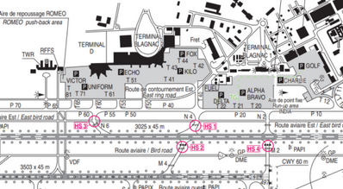

Intersection conflict
Fuel tanker kilo hold on P40 before N4 Iberia CRJ vacating runway 14L at N4 for T42

Slide 3
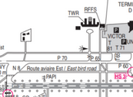
Start push and taxi
If DATALINK has clearance
Avion: Speedbird 373 on U30 with information A ready for push and start
ATC: Push and start approved facing north
ATC: Speedbird 373 taxi holding point N8 runway 14L via T60
ATC: Speedbird 373 contact the tower 118.10

Slide 4
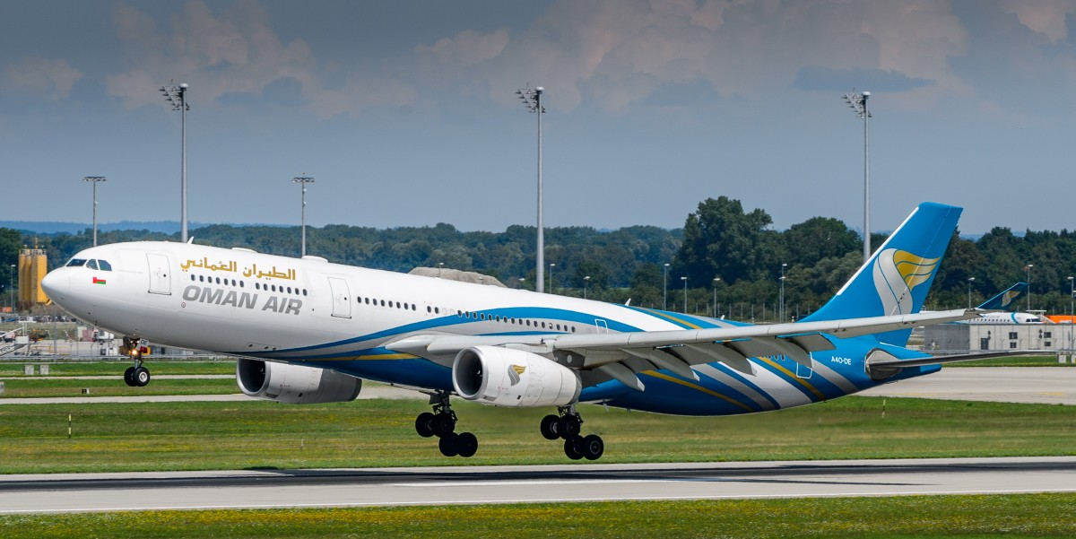
Landing
ATC: Speedbird 345E cleared to land runway 32L wind calm
ATC: F-QO cleared for touch and go runway 32R wind calm after landing right turn to EA
ATC: Airbus 44T cleared option runway 32L wind calm (allows the aircraft to do a touch and go or a full stop landing or a go around at their discretion)
ATC: Speedbird 373 1st left cross runway 14L on the other side contact ground 121.900
ATC: Speedbird 373 vacate 1st left M4 expedite vacating traffic 4 miles final

Slide 5
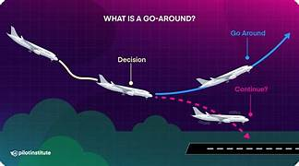
Go around
ATC instructs the aircraft
Speedbird 373 go around (often due to runway being occupied)
Pilot aborts the landing
Speedbird 373 going around

Slide 6
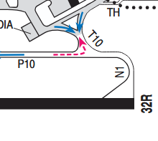
Take off from n1 runway 32R LFBO AT N1
ATC: Atlantic 6B from N1 line up and wait runway 32R
ATC: Atlantic 6B behind the landing traffic from N1 line up and wait behind runway 32R
ATC: Atlantic 6B cleared for takeoff runway 32R wind calm

Slide 7
Immediate take off runway 32R LFBO AT N1
If another aircraft on final but spacing allows ATC will ask plane if ready for an immediate take off. If the reply is YES (Le contrôle aérien demandera à l'avion s'il est prêt pour un décollage immédiat ; si la réponse est OUI)
Atlantic 6B cleared for immediate takeoff runway 32R wind calm

Slide 8
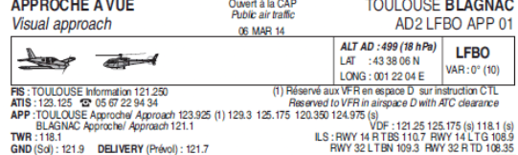
IDENTIFICATION OF AIRCRAFT ON RADAR BY APPROACH CONTROL LFBO
Atlantic 6B radar identified contact approach 129.30

Slide 9
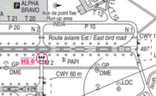
Two aircraft taking off from same runway at same time
Speedbird 353 is taxying to N1 runway 32R
Easyjet 34A is following Speedbird 353 but wants to take off from intersection N2
ATC: Easyjet 34A N2 approved 2300 metres available
ATC: Easyjet 34A : From N2 line up and wait runway 32R
ATC : Speedbird 353 From N1 line up and wait runway 32R number 2 for departure an Easyjet 319 at N2
ATC: Easyjet 34A : From N2 line up cleared for take off runway 32R wind 280/12kts

Slide 10
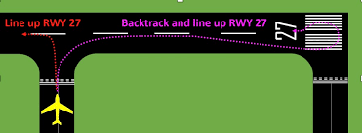
Aircraft backtracking
The taxiways in this scenario are closed for works. The aircraft has to backtrack to be able to take off.
ATC: Postman 55R from N8 enter backtrack line up and wait runway 32R

Slide 11
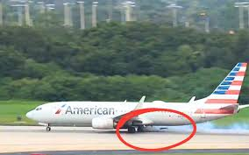
Aborting the take-OFF
ATC instructs to abort the take off prior to V1
Air France 44E Stop Immediately I say again stop immediately
Pilot aborts the take off
Titan 55TR aborting the take-off, I say again aborting the take-off

Slide 12
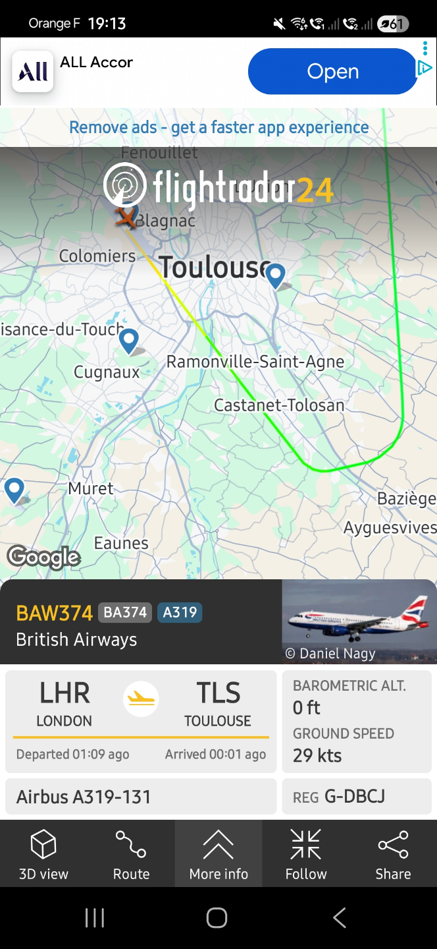
FINAL Approach radar image

Slide 13
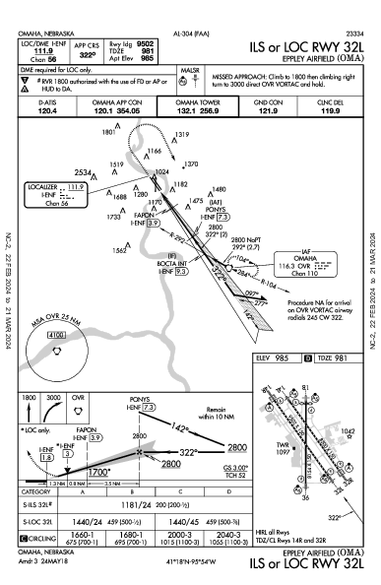
FINAL APPROACH ILS 32L AND LANDING LFBO
ATC: Speedbird 373 turn right heading 280° cleared ILS approach runway 32L
ATC: Speedbird 373 report established ILS
ATC: Speedbird 373 report 4-mile final runway 32L
ATC: Speedbird 373 cleared to land runway 32L wind calm

