Slide 1
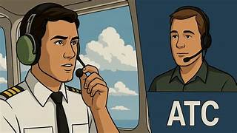
ATC AND PILOT MESSAGES

Slide 2
Specific use of words
The word « CLEARED will only be used for the following:
Cleared to take off
Cleared to land
The word « TAXI » is used for instructions when the plane is on the taxiway
In all other circumstances the word « APPROVED » is used

Slide 3
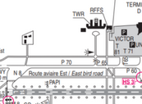
Start push and taxi
Speedbird 373 on U30 with information A for push and start
ATC: Speedbird 373 start approved facing north report ready to taxi
Report ready to taxi speedbird 373
Speedbird 373 ready for taxi
ATC: Speedbird 373 taxi holding point N8 runway 14L via T60
Taxi holding point N8 runway 14L via T60 Speedbird 373
ATC: Speedbird 373 contact the tower 118.10
Tower 118.10 Speedbird 373

Slide 4
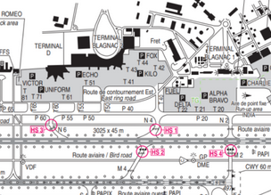
Intersection conflict
ATC: Leader Kilo maintain on P40 before intersection N4 and give way to the Ryanair B737 vacating runway 14L taxying to T40
Vechicle: Leader Kilo maintain on P40 before intersection N4 and give way to the Ryanair B737

Slide 5
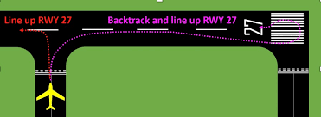
Aircraft backtracking
The taxiways in this scenario are closed for works. The aircraft has to backtrack to be able to take off.
ATC: Postman 55R from Intersection “x” backtrack line up and wait runway 27

Slide 6
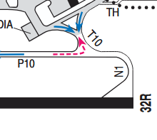
Take off from runway 32R LFBO AT N1
ATC: Atlantic 6B from N1 line up and cleared for take off runway 32R wind calm
Line up and cleared take off runway 32R Atlantic 6B
ATC: Atlantic 6B behind the landing traffic from N1 line up and wait behind runway 32R
Behind the landing traffic from N1 line up and wait behind runway 32R Atlantic 6B
(Once runway is free) ATC: Atlantic 6B cleared for take off runway 32R wind calm
Cleared take off Atlantic 6B

Slide 7
Immediate take off runway 32R LFBO AT N1
If another aircraft on final with enough distance, the air traffic controller will ask the pilot if he is ready for an immediate departure. In the affirmative:
Atlantic 6B cleared for immediate takeoff runway 32R wind calm
Cleared take off runway 32R Atlantic 6B

Slide 8
Canceling take off instruction
ATC Instructs aircraft to cancel take off
Iberia 445G hold position, cancel take off, I say again, hold position
Holding position Iberia 445G
Pilot cancels take off
Iberia 445G is maintaining position

Slide 9
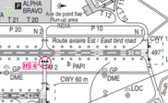
Two aircraft departing at same time
Speedbird 373 is taxying to N1 with Ryanair 243F following. Ryanair 243F wants to take off from Intersection N2
ATC: Ryanair 243F take off from N2 approved 2300 metres available
ATC: From N2 line up cleared for take off runway 32R wind 280/12 kts
Line up from N2 and cleared take off runway 32R Ryanair 243F
ATC: Speedbird 373 from N1 line up and wait runway 32R number 2 for departure Ryanair B737 lining up intersection N2
From N1 line up and wait runway 32R Speedbird 373
ATC: Speedbird 373 cleared for take off runway 32R wind 280/12kts
Cleared for take off runway 32R Speedbird 373

Slide 10
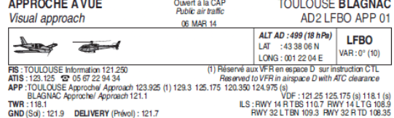
IDENTIFICATION OF AIRCRAFT ON RADAR BY APPROACH CONTROL LFBO
Atlantic 6B radar identified contact approach 129.30
Approach on 129.30 Atlantic 6B

Slide 11
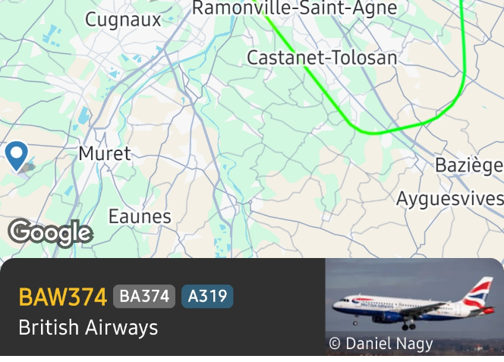
FINAL Approach radar image

Slide 12
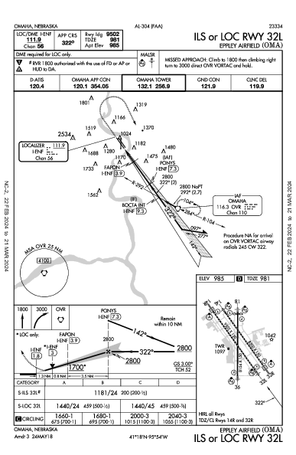
FINAL APPROACH ILS 32L AND LANDING LFBO
ATC: Speedbird 373 turn right heading 280° cleared ILS approach runway 32L , report established
Right heading 280° cleared ILS approach runway 32L , report established Speedbird 373
Speedbird 373 Establised ILS runway 32L
ATC: Speedbird 373 reduce 180 kts and contact tower 118,1
180 kts and contact tower 118,1 Speedbird 373
Tower, good afternoon, Speedbird 373 final runway 32L
ATC: Speedbird 373 report 4-miles final runway 32L
373 report 4-miles final runway 32L Speedbird 373
ATC: Speedbird 373 cleared to land runway 32L wind calm
Cleared to land runway 32L Speedbird 373

Slide 13
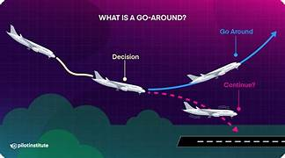
Go around
ATC instructs the aircraft
Speedbird 373 go around wind 280/11kts (often due to runway being occupied)
Going around Speedbird 373
Pilot aborts the landing
Speedbird 373 going around, I say again going around

Slide 14
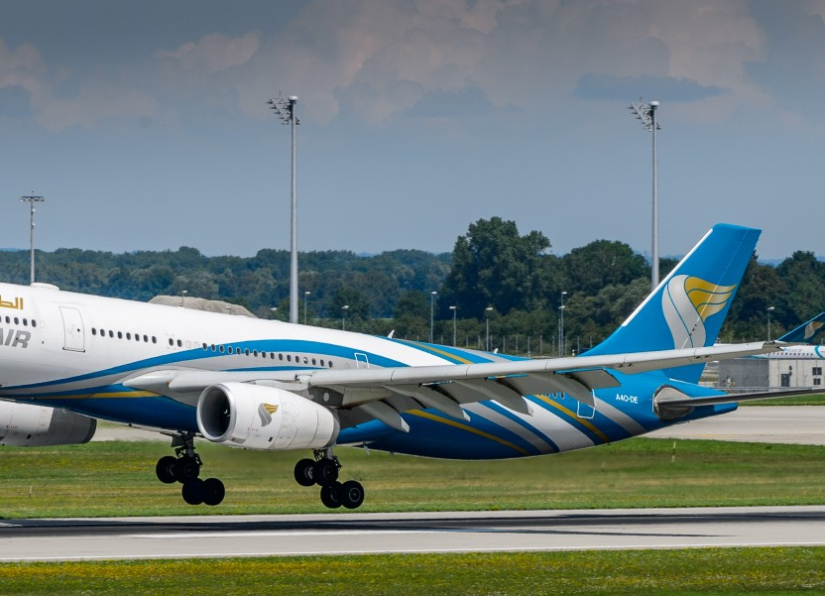
After landing
ATC: Speedbird 373 vacate M4 1st left cross runway 14L on the other side contact ground 121.900
Vacate M4 1st left cross runway 14L on the other side contact ground 121.900 Speedbird 373
OR
ATC: Speedbird 373 vacate 1st left M4 expedite vacating traffic 4 miles final report on M4
Vacate 1st left M4 and report on M4, Speedbird 373

