Slide 1
Learning module 4
Please note that the test is in ENGLISH ONLY and will contain some questions in relation to this module
Veuillez noter que le test est UNIQUEMENT en ANGLAIS et contiendra des questions relatives à cette présentation

Slide 2
Runway emergency situations
English version

Slide 3
Types of Emergency
Runway Incursion
Runway Excursion
FOD to aircraft and debris on the runway
Animals/birds on or in the vicinity of the runway
Flapless landing
Burst tyre
Nose wheel steering gear failure
Landing only with one engine operating

Slide 4
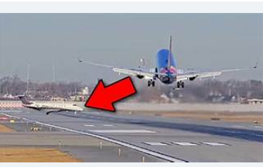
Runway Incursion
A runway incursion is any occurrence at an aerodrome involving the incorrect presence of an aircraft, vehicle or person on the protected area of a surface designated for the landing and take-off of aircraft.
.

Slide 5
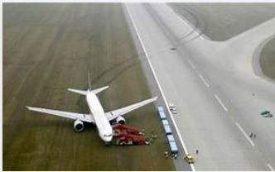
Runway Excursion
A runway excursion (RE) is a veer off or overrun from the runway surface (ICAO). These surface events occur while an aircraft is taking off or landing
A runway excursion is a veer off or overrun from the runway surface.
These surface events occur while an aircraft is taking off or landing

Slide 6
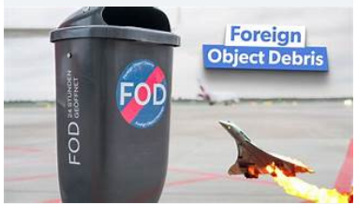
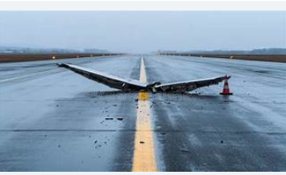
FOD and debris on runway
Foreign Object Damage is caused by debris which is defined as any object, particle, substance or agent that is not where it is supposed to be.
In aviation it is a hazard to aircraft, equipment, cargo or personnel and can result in the aircraft crashing as did the Air France Concorde in Paris

Slide 7
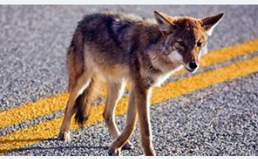
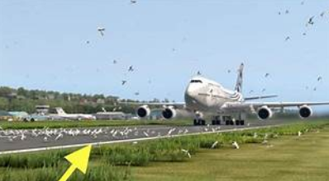
Birds and animals on or near a runway
Wildlife, especially birds, poses a significant threat to aircraft, particularly during takeoff and landing phases.
Bird strikes can cause catastrophic engine failures, structural damage, and, in extreme cases, lead to accidents.

Slide 8
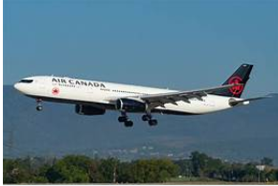
Flapless landing
Flapless landing is often associated with a hydraulic systems failure.
The plane will land at a higher than normal speed leading to a longer landing distance and the risk of the brakes overheating and burst tyres.

Slide 9
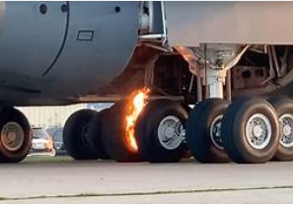
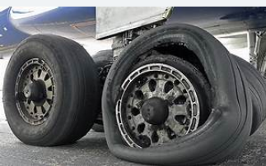
Burst tyres and brake fire
Burst tyres and brake fire following overheating are often associated with the aircraft having to brake in emergency when landing

Slide 10
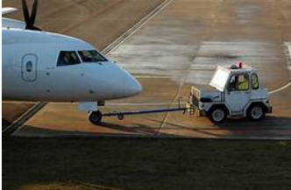
Nose wheel steering failure
The nose wheel steering will not function if there is a hydraulic failure and the aircraft will need to be towed back on to a stand using a tug

Slide 11
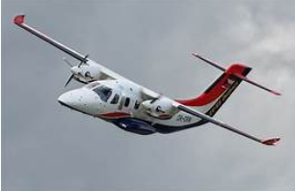
One engine out landing
Landing a twin-engine aircraft with on engine not working is more delicate for the pilot and the risk of a runway excursion is greater

Slide 12
End of module

