Slide 1
Learning Module 5
Please note that the test is in ENGLISH ONLY and will contain some questions in relation to this module
Veuillez noter que le test est UNIQUEMENT en ANGLAIS et contiendra des questions relatives à cette présentation

Slide 2
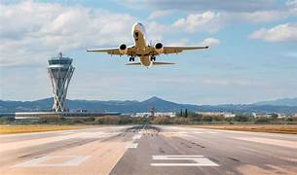
MARKING AND LIGHTING
English version

Slide 3
Introduction
Please look at this powerpoint ,It provides you with simple summary information on:-
Airport signs
Runways
Taxiways
Service roads
Closed runway signs
Holding postion
Stopbar lighting
Runway lighing including PAPI

Slide 4
Lexique
Aire de trafic = APRON or RAMP
Aire de manœuvre = TAXIWAYS AND RUNWAYS
Route de service = SERVICE ROAD
Taxiway = TAXIWAY
Runway = PISTE

Slide 5
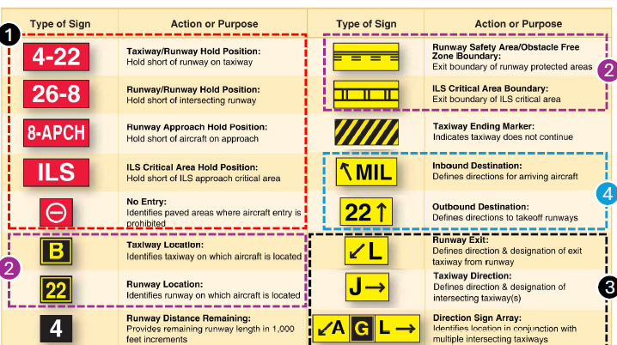
Airport Signs
1 = Mandatory Instruction Signs Red background, White letters
2 = Location Where you are
3 = Direction Taxiways and Intersection
4 = Destination Indicates destination

Slide 6
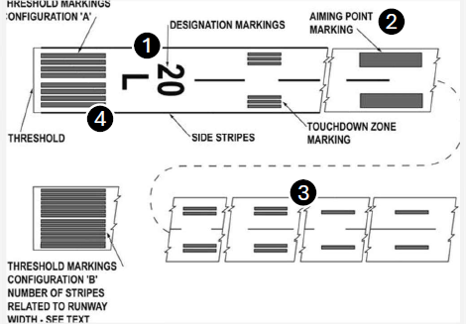
Runway signs
1 = Designators: Numbers, nearest one-tenth magnetic with Centerline Markings
2 = Aiming Point Markings
3 = Touchdown Zone Markers
4 = Threshold Markings

Slide 7
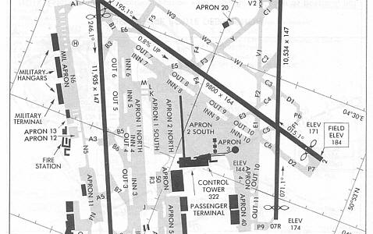
Taxiways
Taxiway surface markings are painted yellow
The most critical taxiway marking is the runway hold position bar
Primary taxiways are identified with a letter
Taxiway connectors are identified with a letter and number combination as well as at some airports with a name such as « outer » or « inner »

Slide 8
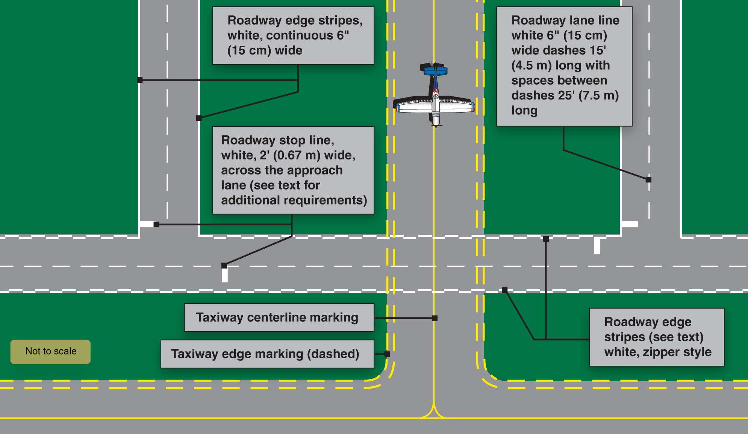
Service roads

Slide 9
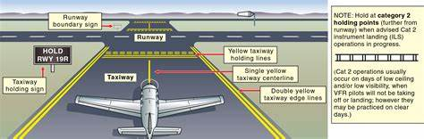
Runway Holding Position markings on Taxiways

Slide 10
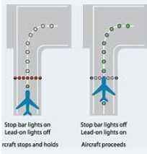
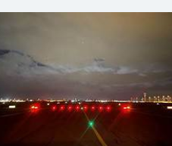
Stop bar lights
A stop bar is a row of red lights embedded in the ground at runway holding points, providing a mandatory stop signal to prevent unauthorized entry onto the runway, especially in low visibility.

Slide 11
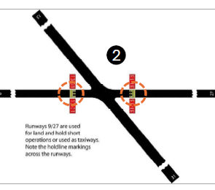
Runway Holding Position Markings on Runways

Slide 12
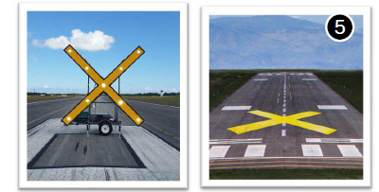
Closed runways

Slide 13
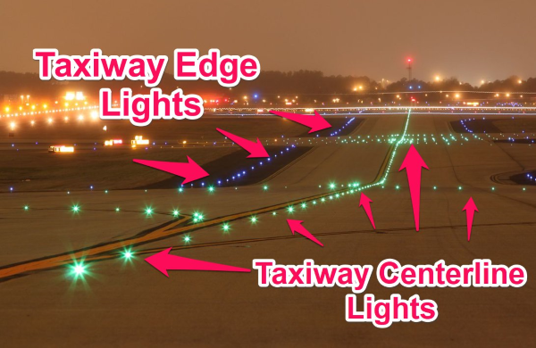
Taxiway lights
Centre lights GREEN
Edge lights BLUE

Slide 14
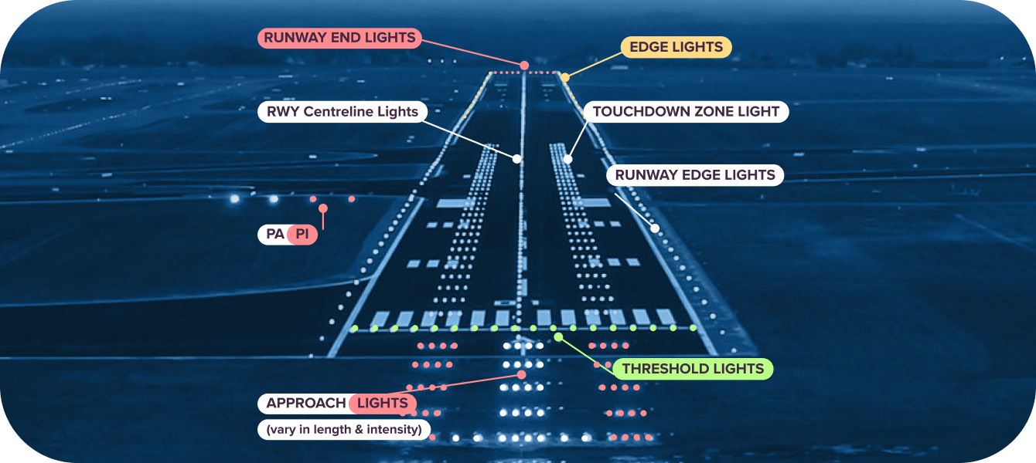
Runway lights

Slide 15
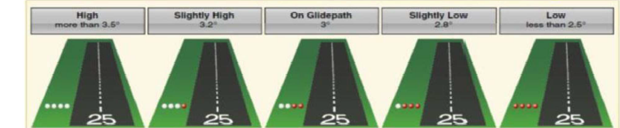
PAPI
Precision Approach Slope Indicator
When 2 red lights and 2 white lights are showing the aircraft is established on the glide path

Slide 16
End of module

