Slide 1
Learning Module 3
Please note that the test is in ENGLISH ONLY and will contain some questions in relation to this module
Veuillez noter que le test est UNIQUEMENT en ANGLAIS et contiendra des questions relatives à cette présentation

Slide 2
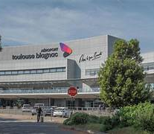
AIRPORT English Version

Slide 3
Introduction
Please look at this powerpoint ,It provides you with simple summary information on:-
Parts of the airport
Apron
Airport buildings
Hotspots
Air traffic control tower
Firefighting
The test IN ENGLISH ONLY will contain some questions in relation to this powerpoint
A french version for the training purposes is to be found

Slide 4
Lexique
Apron or ramp = Aire de trafic
Taxiways and runways = Aire de manœuvre
Service road = Service road
Stand = Parking avion
Remote Stand = Parking avion éloigné du terminal
Taxiway = Taxiway
Runway = Piste
Landside = Côté Ville
Airside = Côté piste

Slide 5
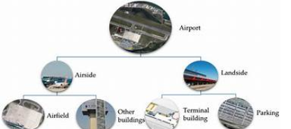
Airside/landside
Part of the airport has no restricted access and is known as landside.
The other part is known as airside and is a restricted area where all passengers and personnel must pass through a security check area

Slide 6
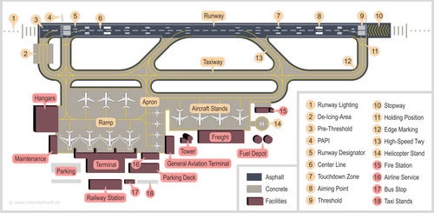
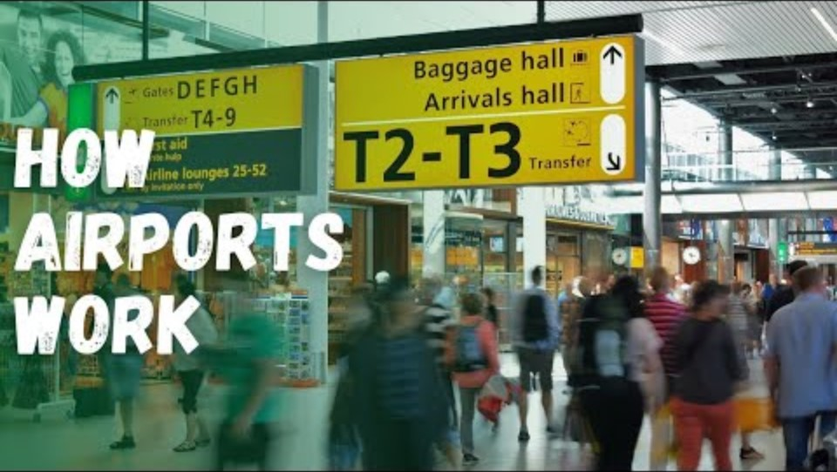
Parts of an airport

Slide 7
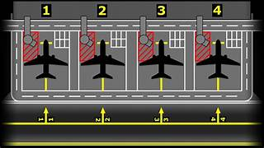
Apron (also known as the ramp or aircraft parking)
The apron is the area where the aircraft are parked also known as the ramp. Each aircraft has a stand number allocated to it.
The markings are a combination of yellow and white as per the example shown

Slide 8
Airport Buildings
Remote parking locations for aircraft
Hangars
Freight zone
Fuel Farm
Technical buidlings
Fire station
General Aviation terminal

Slide 9
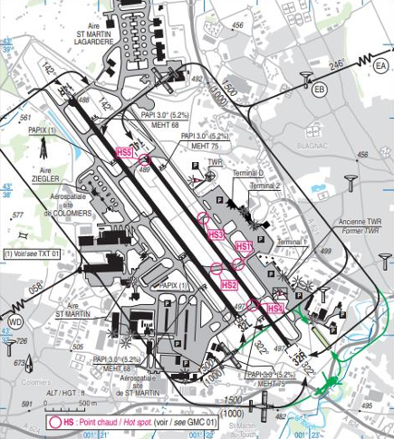
Hotspots
Hotpsots as indicated on the airport chart are areas where there in a greater chance of an accident or incident
The hotspots apply to both aircraft and to ground vechicles

Slide 10
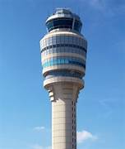
Air Traffic Control Towers
Air traffic control towers are built to see all the movement surfaces on the airport and the areas around an airport
Towers’ heights vary depending on the layout of the airport
Tower hours of operation vary
Not every airport has an air traffic control tower
All movement around the airfield is under the control of the air traffic controllers

Slide 11
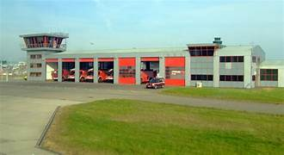
Aircraft Rescue and Firefighting
ARFF = Airport rescue and fire fighting
ARFF requires special training to work around and with aircraft
ARFF Firefighters respond to accidents, incidents and medical emergencies

Slide 12
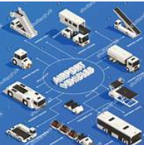
Some airport vechicles
Tug
Tow bar
Catering truck
Fuel truck
Bagage trolley
Follow me car
Bus
Steps

Slide 13
End of Module

