Slide 1
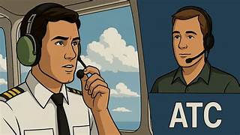
Example of exchangeof messages between ATC and pilots at Toulouse Blagnac
English version only
Additional material for training purposes

Slide 2
Specific use of words
The word « CLEARED » will only be used for the following:
Cleared for take off
Cleared to land
The word « TAXI » is used for instructions when the plane is on the taxiway
In all other circumstances the word « APPROVED » is used

Slide 3
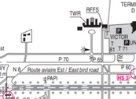
Start push and taxi
Speedbird 373, on U30 with information A for push and start
ATC: Speedbird 373, start up approved facing north report ready to taxi
Pushing back will report ready to taxi speedbird 373
Speedbird 373 ready to taxi
ATC: Speedbird 373, taxi holding point N8 runway 14L via T60
Taxing holding point N8 runway 14L via T60 Speedbird 373
ATC: Speedbird 373, contact tower 118.105
Contacting tower 118.105 Speedbird 373

Slide 4
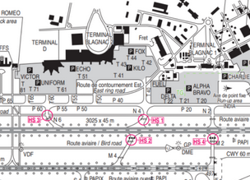
Intersection conflict
ATC: Leader Kilo maintain on P40 before intersection N4 and give way to the Ryanair B737 vacating runway 14L taxying to T40
Vehicle: Leader Kilo maintain on P40 before intersection N4 and giving way to the Ryanair B737

Slide 5
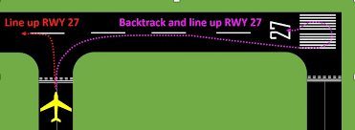
Aircraft backtracking
The taxiways in this scenario are closed for works. The aircraft has to backtrack to be able to take off.
ATC: Postman 55R backtrack runway 27 line up and wait

Slide 6
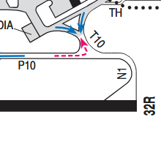
Take off from runway 32R LFBO AT N1
ATC: Atlantic 6B line up runway 32R intersection N1cleared for take off wind calm
Lining up and cleared take off runway 32R Atlantic 6B
ATC: Atlantic 6B behind the landing traffic line up runway 32R intersection N1 and wait behind
Behind the landing traffic lining up runway 32R intersection N1and wait behind, Atlantic 6B
(Once runway is free) ATC: Atlantic 6B runway 32R cleared for take off wind calm
Taking off Atlantic 6B

Slide 7
Immediate take off runway 32R LFBO AT N1
If another aircraft is on final with enough distance, the air traffic controller will ask the pilot if he is ready for an immediate departure. In the affirmative:
Atlantic 6B runway 32R cleared for immediate takeoff wind calm
Taking off Atlantic 6B

Slide 8
Canceling take off instruction
ATC Instructs aircraft to cancel take off
Iberia 445G stop immediately, Iberia 445G stop immediately
Stopping Iberia 445G

Slide 9
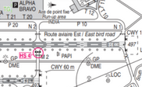
Two aircraft departing at same time
Speedbird 373 is taxying to N1 with Ryanair 243F following. Ryanair 243F wants to take off from Intersection N2
ATC: Ryanair 243F (Intersection) N2 is approved 2300 metres available
ATC: Ryanair 243F line up runway 32R intersection N2 cleared for take off wind 280/12 kts
Lining up runway 32R intersection N2 and taking off, Ryanair 243F
ATC: Speedbird 373, line up runway 32R intersection N1 and wait
Lining up and waiting runway 32R intersection N1, Speedbird 373
ATC: Speedbird 373 runway 32R cleared for take off wind 280/12kts
Taking off runway 32R Speedbird 373

Slide 10
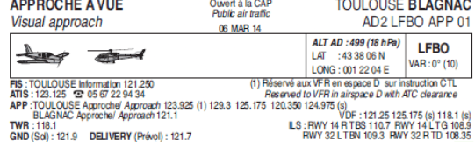
IDENTIFICATION OF AIRCRAFT ON RADAR BY APPROACH CONTROL LFBO
Atlantic 6B radar identified contact approach 129.30
Approach on 129.30 Atlantic 6B

Slide 11
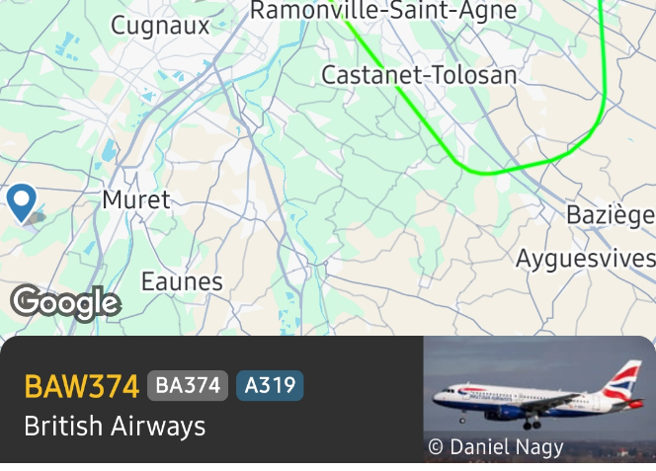
FINAL Approach radar image

Slide 12
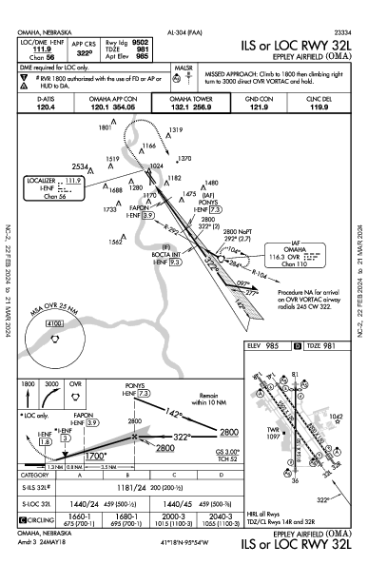
FINAL APPROACH ILS 32L AND LANDING LFBO
The plane is appx 4 minutes from landing when he intercepts the ILS
ATC: Speedbird 373 turn right heading 280° cleared ILS approach runway 32L , report established
Right heading 280° cleared ILS approach runway 32L , report established Speedbird 373
Speedbird 373 Establised ILS runway 32L
ATC: Speedbird 373 reduce 180 kts and contact tower 118,105
180 kts and contact tower 118,105 Speedbird 373
Tower, good afternoon, Speedbird 373 final runway 32L
ATC: Speedbird 373 report 4-miles final runway 32L
373 report 4-miles final runway 32L Speedbird 373
ATC: Speedbird 373 Runway 32L cleared to land wind calm
Landing runway 32L Speedbird 373

Slide 13
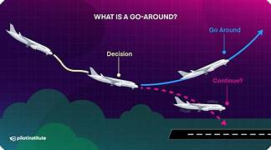
Go around
ATC instructs the aircraft
Speedbird 373 go around (often due to runway being occupied)
Going around Speedbird 373
Pilot aborts the landing
Speedbird 373 going around

Slide 14
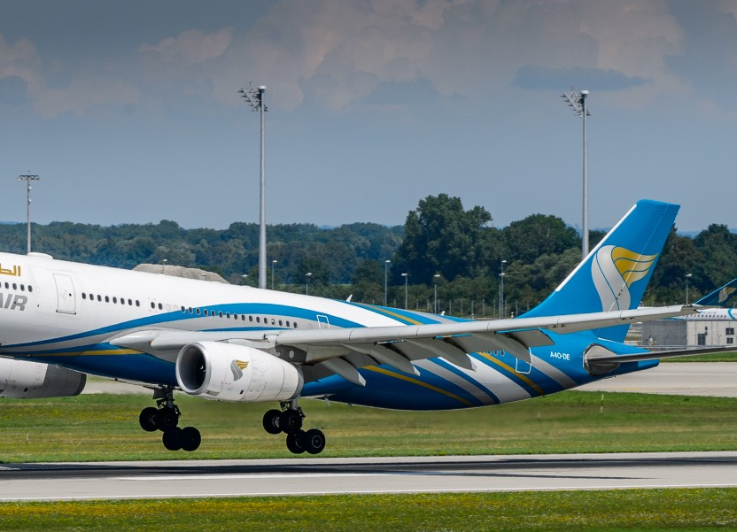
After landing
ATC: Speedbird 373 vacate M4 1st left cross runway 14L on the other side contact ground 121.905
Vacating M4 1st left crossing runway 14L on the other side contacting ground 121.905, Speedbird 373
OR
ATC: Speedbird 373 vacate 1st left M4 expedite vacating traffic 4 miles final report on M4
Vacate 1st left M4 and report on M4, Speedbird 373

