Slide 1
Learning module 6
Version française –Vous devez étudier la version anglaise, car les questions des tests sont uniquement en anglais. La version française est là pour vous aider et vous servir d'aide-mémoire.

Slide 2
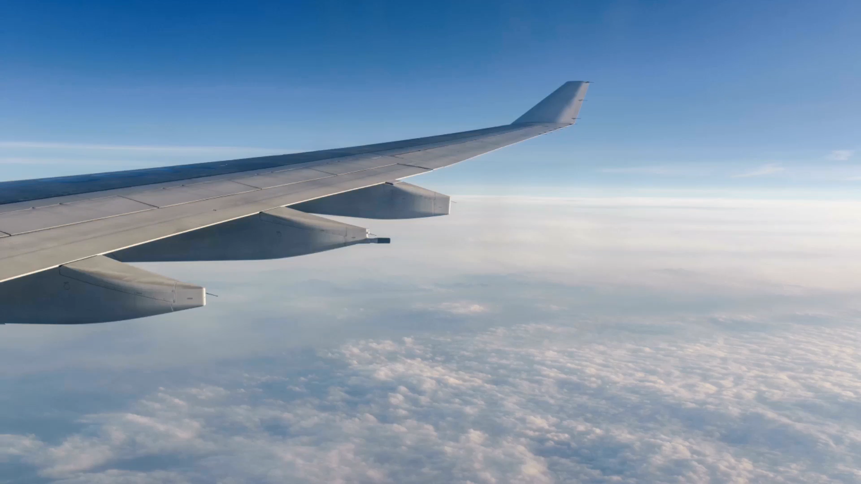
Parts of an aircraft
English version

Slide 3
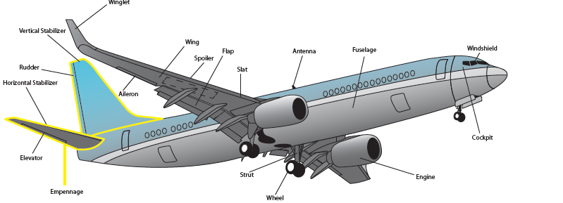
Diagram of main parts of an aircraft

Slide 4
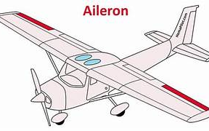
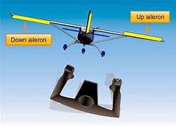
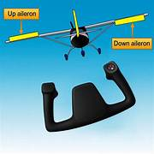
Ailerons
The ailerons are located at the rear of the wing with one on each side.
They work opposite to each other, meaning that when one is raised, the other is lowered.
By doing this, they roll the aircraft sideways, causing the aircraft to turn.

Slide 5
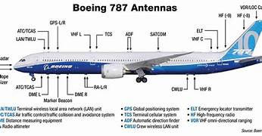
Antennas
There are numerous radio antennas located around an aircraft,

Slide 6
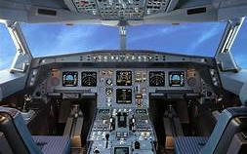
Cockpit
The cockpit, sometimes referred to as the Flight Deck, is where the pilots sit.
It contains the flight controls, which move the airplane, as well as all the buttons and switches used to operate the various systems

Slide 7
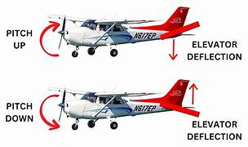
Elevator
As the name implies, the elevator helps “elevate” the aircraft.
It is located on the tail of the aircraft and directs the nose of the aircraft either upwards or downwards to make the airplane climb and descend.

Slide 8
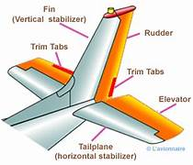
Empennage
This name stems from the French word “empenner”.
The empennage is the name given to the entire tail section of the aircraft, including both the horizontal and vertical stabilizers, the rudder and the elevator.

Slide 9
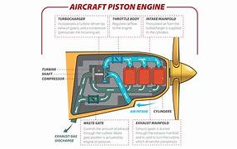
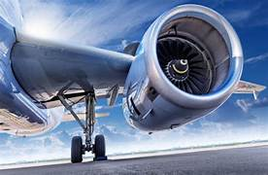
Engine
An airplane has at least one, or as many as eight engines, which provide the thrust needed to fly.
The basic function of taking the air that’s in front of the aircraft, accelerating it and pushing out behind the aircraft.
Jet powered aircraft perform this function by compressing the air using turbines,
Propeller-powered aircraft use a propeller mounted to the engine.

Slide 10
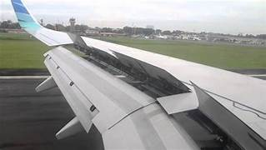
Flaps
Flaps are a “high lift / high drag” device.
Not only do they improve the lifting ability of the wing at slower speeds but when extended fully they also create more drag.
This means an aircraft can descend (or lose altitude) faster, without gaining airspeed in the process

Slide 11
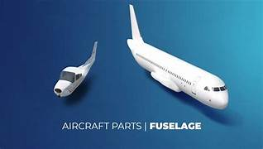
Fuselage
The fuselage, from the French word “fuselé”
Is is the portion of the airplane used to join the other parts together.
It is the body of the aircraft and holds the passengers and cargo safely inside.

Slide 12
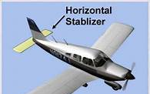
Horizontal Stabilizer
The horizontal stabilizer is quite simply an upside-down wing, designed to provide a downward force (push) on the tail.

Slide 13
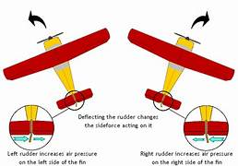
Rudder
The rudder is attached to the vertical stabilizer.
It is located on the tail of the aircraft. It works identically to a rudder on a boat, helping to steer the nose of the aircraft left and right.

Slide 14
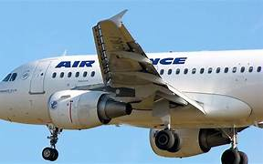
Slats
A slat is a “high lift” device found on jet-powered aircraft.
Slats are similar to the flaps except they are mounted on the leading edge of the wing..

Slide 15
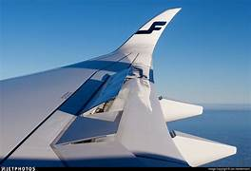
Spoilers
The spoiler’s function is to disrupt, or spoil, the flow of air across the upper surface of the wing.
They are usually found on larger aircraft, which can have two types installed.

Slide 16
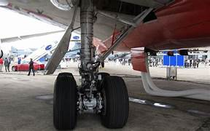
Struts
The struts are part of the undercarriage known as the landing gear.
Their function is the same: to absorb the impact of the landing as the aircraft touches the ground.
Each strut contains a shock absorber, hydraulic oil and gasses which work together to reduce the impact felt by the occupants

Slide 17
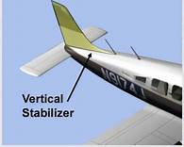
Vertical Stablizer
The vertical stabilizer is designed to stabilize the left-right motion of the aircraft.

Slide 18
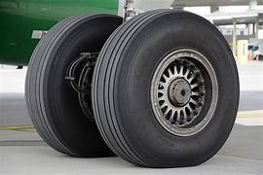
Aircraft wheels
The wheels are another part of the undercarriage, or landing gear.
Aircraft wheels are filled with nitrogen instead of air.
This is because the pressure of nitrogen gas changes very little with changes in altitude or temperature.

Slide 19
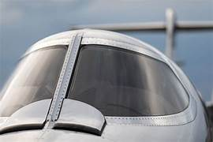
Windshield
The windshield on smaller aircraft is usually made from polycarbonate, a type of plastic, while pressurized airplanes use a sandwich of plastic and glass layers, called a laminate.
This is necessary to absorb the impact of birds, insects and other debris that may collide with the windshield as the airplane flies at close to the speed of sound.

Slide 20
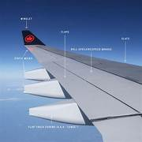
Wing
The wing provides the majority of the lift an airplane requires for flight.
Its shape is specifically designed for the aircraft to which it is attached.
On most aircraft, the interior of the wing is also used to store the fuel required to power the engines.

Slide 21
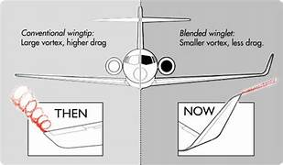
Winglet
Some aircraft wings have an additional component called a winglet, which is located at the end of each wing.
Its purpose is to reduce the drag (or air resistance) the wing produces as it pushes through the air.
This not only allows the airplane to fly faster, but also means it burns less fuel,

Slide 22
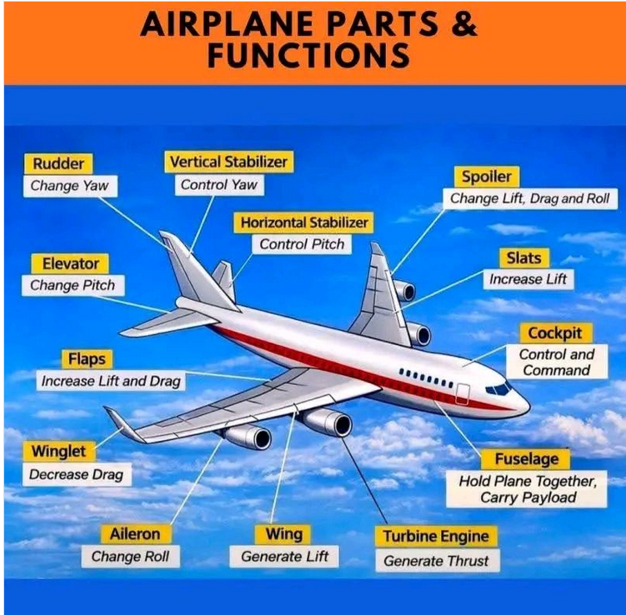
Summary of parts and thier use

Slide 23
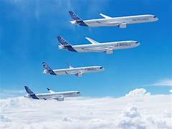
End of presentation

